Slide 1
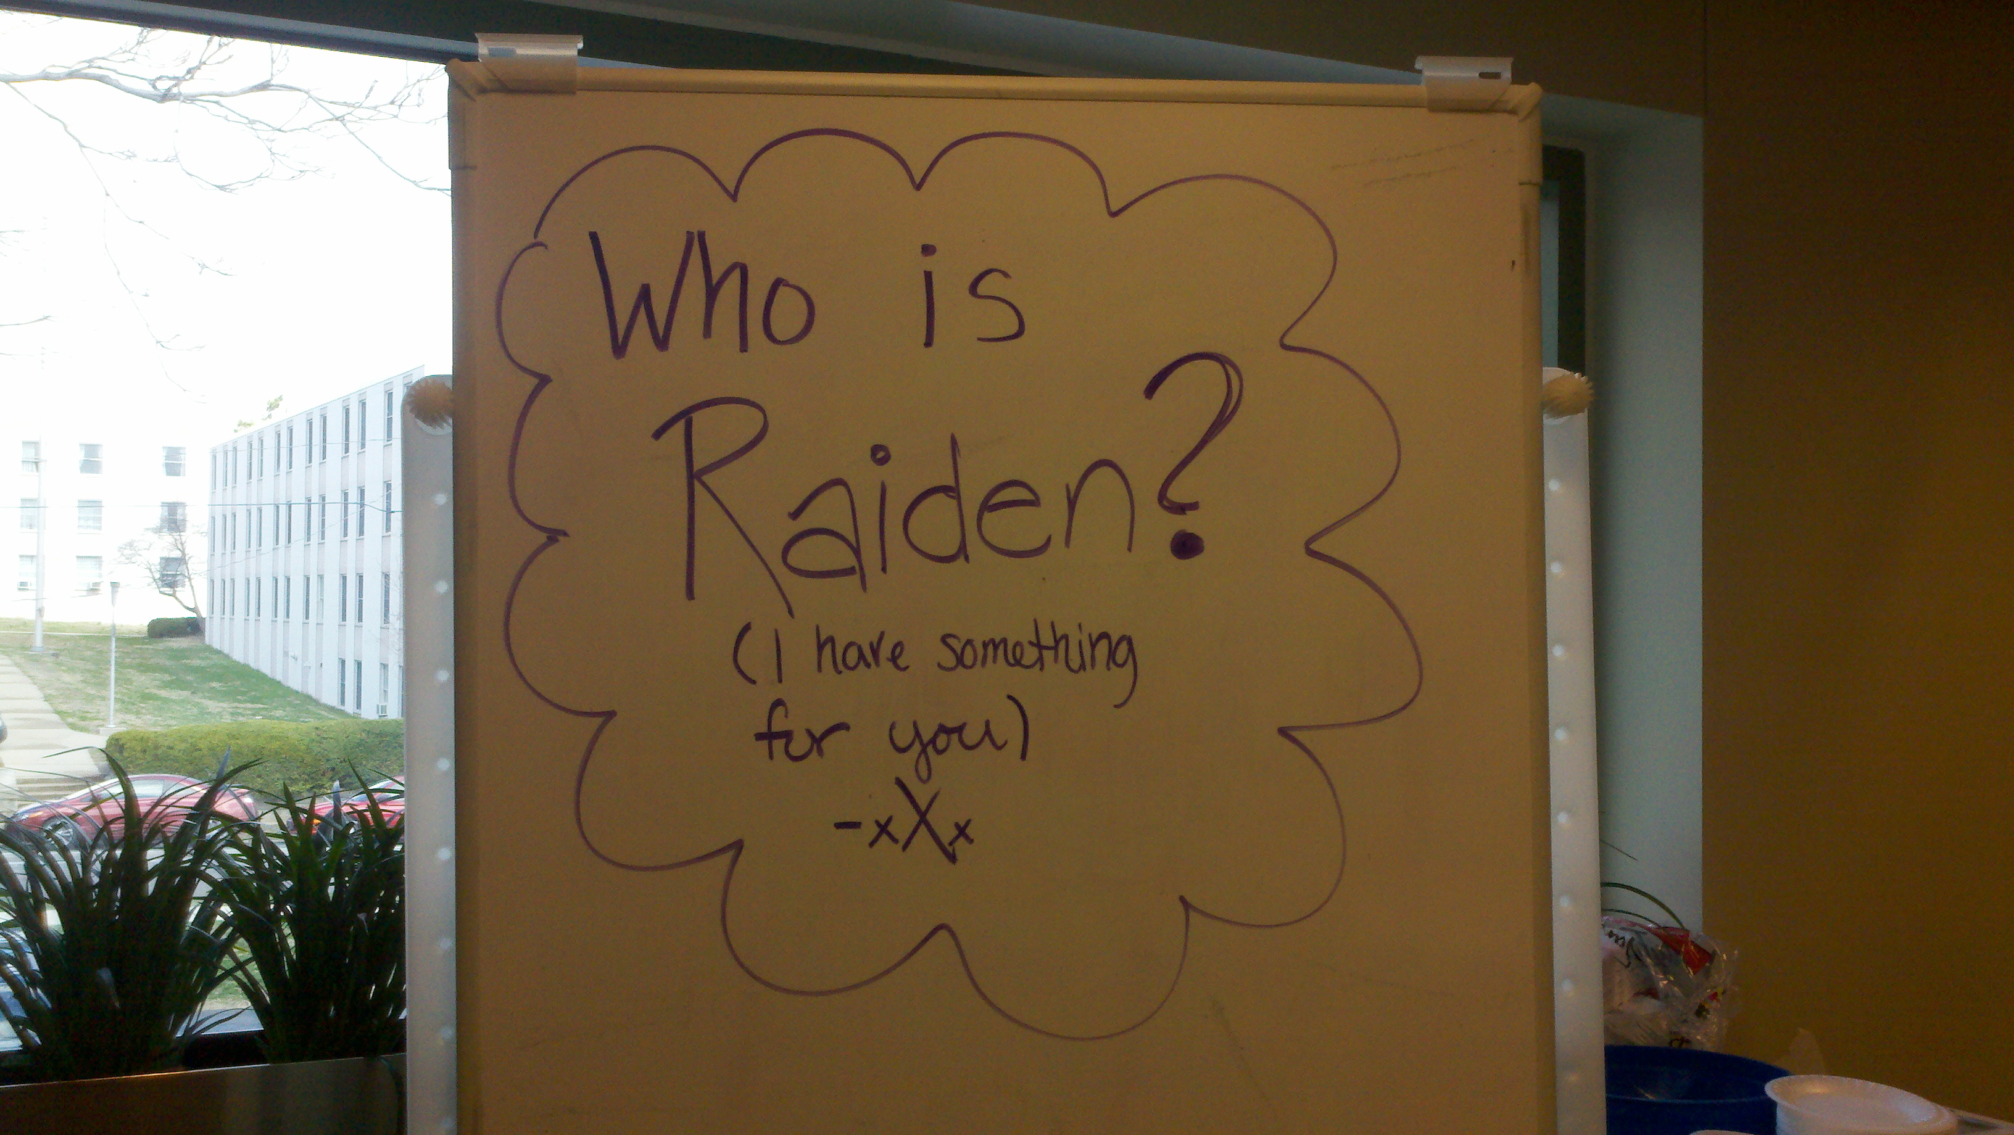
Alternate Reality Games
Robert Begley
4/27/11
Notes:
Good evening everyone, my name is Robert Begley and thank you for coming to my capstone presentation tonight. For my capstone project I created an alternate reality game with an HCI perspective.

Slide 2
Overview
Final Design
Introduction
Core
Research
Research Insights
Concept Development and Prototypes
Evaluations
Final Redesign
Future Considerations
Reflection

Slide 3
What is an alternate reality game?
Notes:
Alternate reality games take place in both the online, virtual, world as well as the physical world. Players progress through these games by completing tasks based on the story of the game through a variety of interactions like email, texting, phone calls, and other methods.
I set out to create an alternate reality game. This type of game is unique and different compared to traditional styles of gaming. Players aren’t in front a screen, at least 100% of the time. They do things in the real physical world, based on the context and story of the game, and also do things in a virtual world. This could take the form of a website, animations, videos, etc.
A major focus of ARGs are their many mediums of interaction as part of the game. So players play via phone calls, text messages, blogs, message boards, cameras, email, really anything that can be incorporated into the context of the game will work.

Slide 4
Final Design
Introduction
Core
Research
Research Insights
Concept Development and Prototypes
Evaluations
Final Redesign
Future Considerations
Reflection

Slide 5
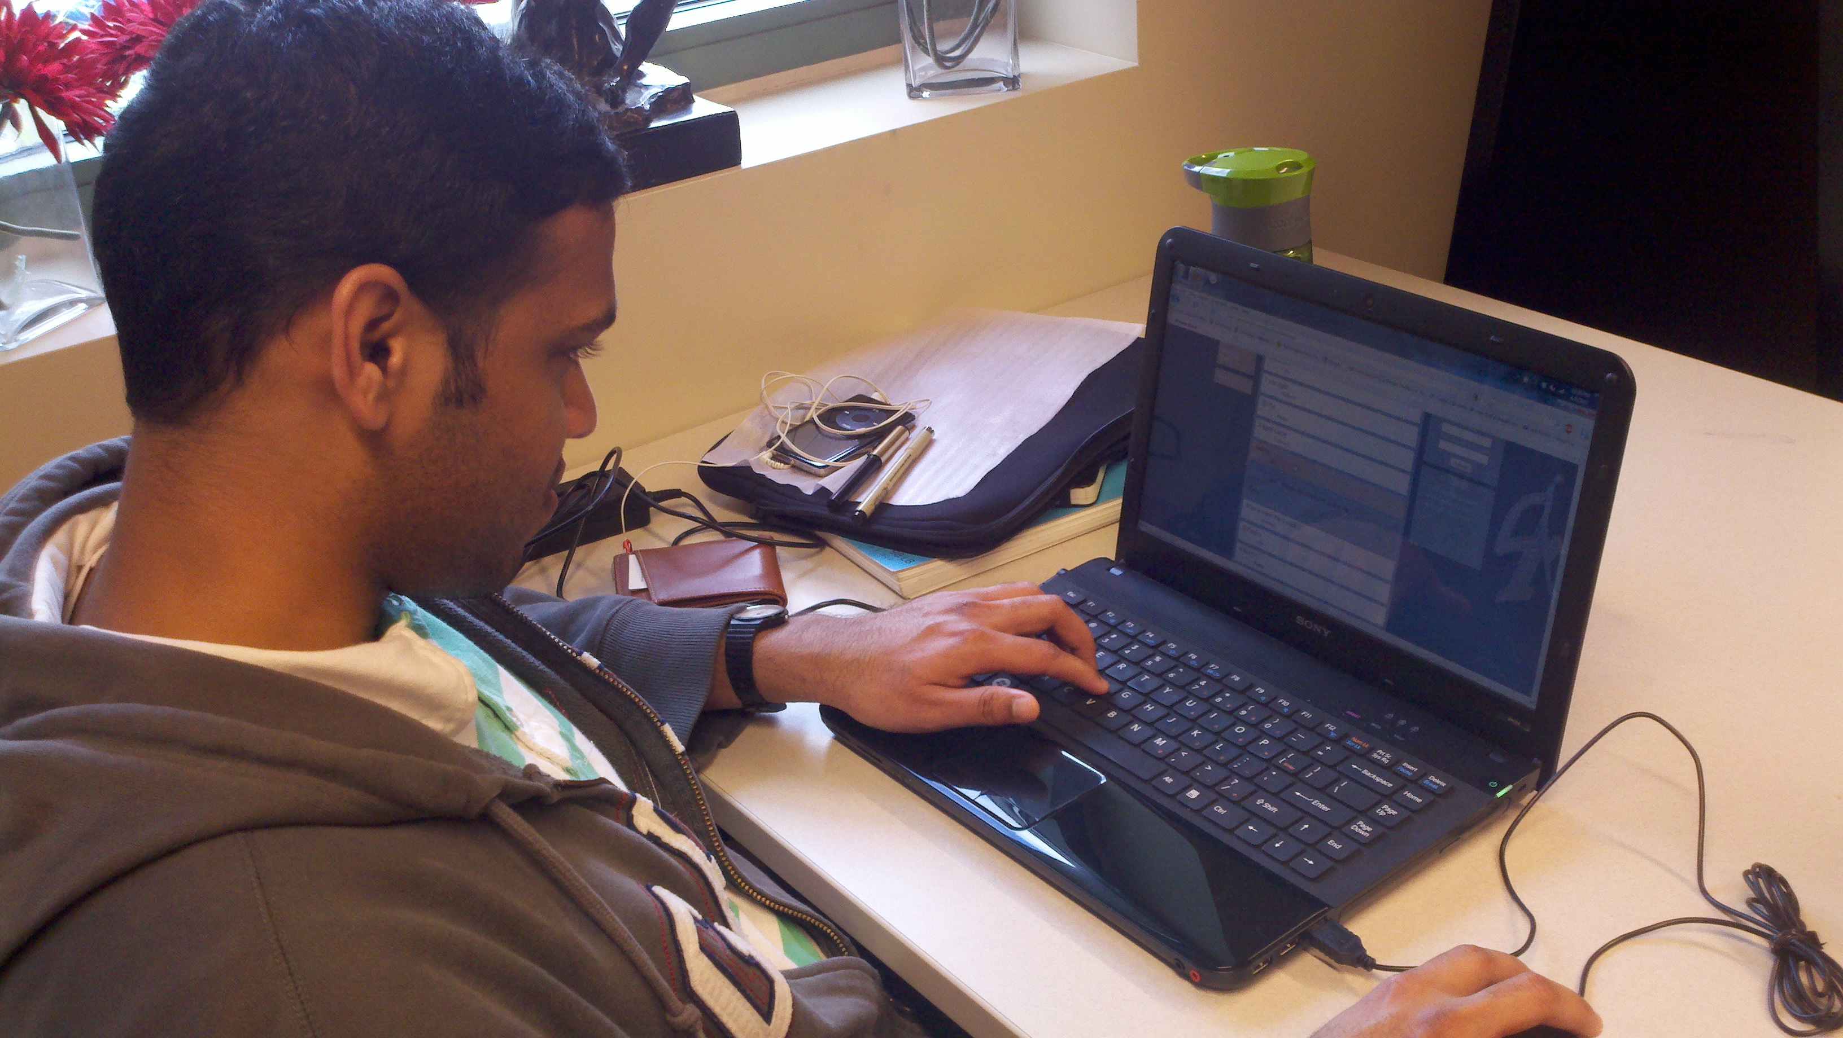

Slide 6
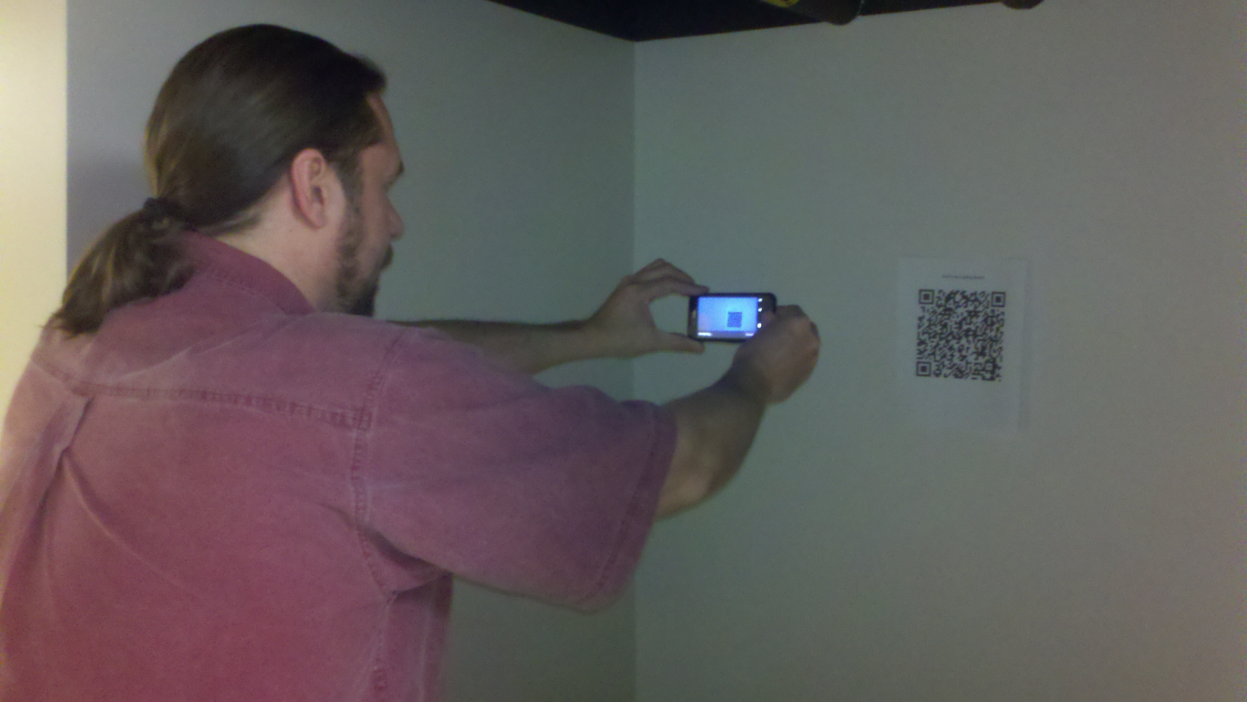

Slide 7
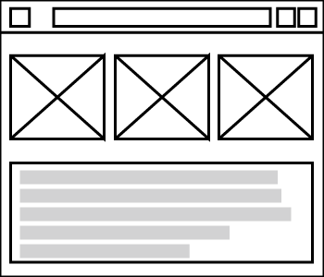
websites
Virtual Component
email
SMS
The Game
Third Party
Organization
Artifacts
Locations
Physical Component
Environments
Notes:
I made this illustration to help explain my capstone. Now this game is a system.
Two parties – the people who run the game, so further the story along, maintain it, etc, they are called the “puppet masters” or rather a third party who is running this game. They set up the virtual component and the physical component by creating websites, sending emails, text messages, make phone calls to players, and provide environments and locations for players to play in. In addition they will also become part of the game and can either help players along or act as adversaries.
The other party, are the players. Players will interact with game and progress through the story through whatever means necessary as part of the game. So players will receive tasks to go off and do something either in real life or online.

Slide 8
Final Design
Introduction
Core
Research
Research Insights
Concept Development and Prototypes
Evaluations
Final Redesign
Future Considerations
Reflection

Slide 9
Explore Gaming
Introduction
Notes:
Initially, I wanted to explore gaming, I enjoy games and thought it was at least a good starting point for capstone.
Early on when I decided to look at gaming, I immediately thought, how cool and interesting it would be to make one, specificlaly an alternate reality game.
I looked at ARGs as an opportunity space. An opportunity to explore gaming in context to HCI.
This is an opportunity space. I did not go out and specifically find a problem to fix. I wanted to explore the space to see what could be done with it.
I set out to explore how the medium of gaming and technology could be used to solve other problems.
Because many people play games......

Slide 10
An Opportunity Space
Introduction
Notes:
So I viewed games as an opportunity space. I didn’t start with a problem to iterate over to find solutions, but rather as a space to explore.
I looked at ARGs as an opportunity space. An opportunity to explore gaming.
This is an opportunity space. I did not go out and specifically find a problem to fix. I wanted to explore the space to see what could be done with it.
I set out to explore how the medium of gaming and technology could be used to solve other problems.
Started out as an opportunity space. Not a specific problem to solve. This made it easier to step back and look at how this concept/design could be used to solve specific problems since I wasn’t starting with one in the first place. As I tested, evaluated, and gained feedback..
So at this point I hadn’t nailed down my core, just yet.

Slide 11
Physical and Social Interaction
Introduction
Notes:
I also wanted to look at physical and social interaction. I wanted to have a design where people communicated with each other, especially looking at face to face interaction.
I wanted to look at physical and social interaction, especially face to face.
I wanted my capstone to focus on the real world. I didn’t want to just design an interface for something. I wanted to incorporate people doing something together and being able to include the real world.
Ultimately, I wanted to look at how these research concepts would inform my design.

Slide 12
Create an alternate reality game for college aged gamers who are already familiar with gaming to provide them with a different and unique gaming experience
Core
Notes:
Ultimately, my core became to READ SLIDE
I was looking at college aged students. In their 20’s. My goal was to create an experience playing a differently styled game for people who already play video games. Basically, this was going to be an experiment!
I initially interviewed and wanted to look at college or graduate student aged students who were already familiar with playing games. My initial goal was to see how this user group would experience playing a different style of game as opposed to traditional console/pc gaming where you are in front of a screen and controlling an avatar in 2D or 3D space.
However, as I went through the process of designing this system, it occurred to me that, ideally, the target user group is going to depend on the context and use of the game that is created. So if it’s a game that is being used to help educate kids, then the target user is going to be kids.

Slide 13
Final Design
Introduction
Core
Research
Research Insights
Concept Development and Prototypes
Evaluations
Final Redesign
Future Considerations
Reflection

Slide 14
Research
3,000,000,000
Hours per week Globally
Notes:
Why is gaming important? A game researcher, Jane McGonigal has concluded that, globally, people spend 3 billion hours a week playing video games. That is a huge number, which means that gaming is important to people.
In fact, from Jane McGonigal’s research, people spend 3 billion hours per week playing games. That’s a lot of time. Jane McGonigal is a researcher specializing in alternate reality games and believes that gaming is a valuable medium for improving the world.
Well, it’s important because, as Jane Mcgonigal points out from her research, people spend 3 billion hours per week playing games. This is a lot of time spent during the week. So why not use the medium of gaming to facilitate accomplishing real life goals?
Be very clear as to why this is interesting, why it’s important, and what it is! (JM VIDEO CITE NUMBERS). Why games?
Wants to make saving the world in real life as easy as it is in video games.
Spend 3 billion hours a week playing games.
Need to spend 21 billion hours a week playing games.
To solve hunger, poverty, climate change, etc
http://www.ted.com/talks/jane_mcgonigal_gaming_can_make_a_better_world.html

Slide 15
Experience Design
Research
Notes:
I also saw creating an ARG as being able to provide a unique experience for gamers.
Using games, specifically ARGs, as a medium to facilitate experience design and CSCW concepts including collaboration, awareness of others
I am doing my capstone because I want to connect people in real life and technology can facilitate that. The purpose of my design is to bring people who don't know each other together mediated through a game played in the real physical space as well as a virtual space (mainly a website).

Slide 16
CSCW
Research
Collaboration, Colocation, Awareness, Trust
(Jarvenpaa & Leidner, Olson & Olson, Teasley, Covi)
Notes:
I looked at Computer Supported Cooperative Work. I was looking at how CSCW topics could inform my own design.
I looked at a number of research within Computer Supported Cooperative Work topics like collaboration, colocation, and awareness because these are relevant in ARGs today and would be relevant in the ARG that I create. I wanted to see how these works would influence the way I designed my ARG.
I wanted to look at collaboration and colocation because players would be working together in virtual and physical space.
I wanted to look at awareness because as part of a competitive game it was important to know where you stood in comparison to where your competition stood.
I wanted to look at trust because players, although competing would still need to be able to trust each other, specifically with tasks that involved players working together.
I wanted to look at how these concepts would inform my design.
(Olson, Teasley, Covi, Olson 113)

Slide 17
Mixed Reality
Research
“Between the extremes of real life and Virtual Reality lies the spectrum of Mixed Reality, in which views of the real world are combined in some proportion with views of a virtual environment” (Drascic and Milgram)
Notes:
I also looked at mixed reality. As stated by Drascic and Milgram, mixed reality lies between real life and virtual reality, complimenting each other. I wanted to see how uses of mixed reality were going to inform my design.
I also looked at mixed reality. Mixed reality as stated by Drascic and Milgram lies real life and virtual reality. I wanted to see how the idea of mixed reality could also inform my design.
And so I looked at some exemplars of alternate reality games.
And so I looked at exemplars.
I also looked at research focusing on mixed reality, because of how similarly related it is to what Alternate reality games are.
One example of this is a design called Double Dribble, where the researchers <Read quote>
So I looked at mixed reality research as a way to help inform my own design.

Slide 18
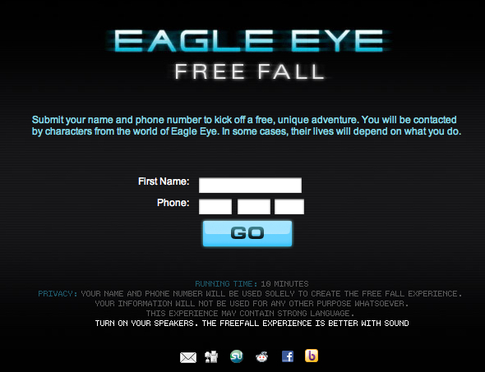
Notes:
One exemplar is Eagle Eye Free Fall. Created to help promote the movie, Eagle Eye. Players begin the game by typing in their name and phone number. The game lasts ten minutes and through that period of time the player interacts with the game via phone calls, keyboard input, and an animated audio/video experience.
Eagle Eye Free Fall, an ARG to help promote the movie, Eagle Eye. A player simply types in their name and phone number to start the game. Lasts roughly 10 minutes and makes heavy use of audio and visual elements (animation and pre recorded real life videos) to create a unique experience that relates to the movie. Players receive phone calls from the game and are also tasked to interact within the game’s web interface.
Image Source: http://www.eagleeyefreefall.com

Slide 19
Notes:
One exemplar is Eagle Eye Free Fall. Created to help promote the movie, Eagle Eye. Players begin the game by typing in their name and phone number. The game lasts ten minutes and through that period of time the player interacts with the game via phone calls, keyboard input, and an animated audio/video experience.
Image showing a player typing in the license plate found in order to progress through the game.
Image Source: http://www.youtube.com/watch?v=9rOu0YFyalo

Slide 20
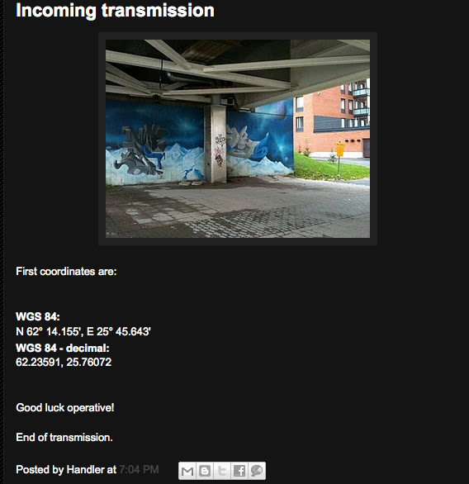
Notes:
Another exemplar is an ARG called Reality Game X. Maintained and updated by a blog, the game requires players to interact with each other by finding and visiting real world locations. Players also play the game via phone calls and emails.
A cold war themed alternate reality game. This example shows an image where players are tasked to find a real world location with the given GPS coordinates. At these locations players meet each other and exchange information as part of the game. Players also interact with this game via phone calls, emails, and the blog where videos and other updates are posted.
There are plenty out there, many of which are used as viral advertising especially for tv shows and movies.
Image Source: http://realitygamex.blogspot.com/2010/09/incoming-transmission.html

Slide 21
Interviews
Research
Notes:
I also conducted interviews with students who play or are familiar with video games. I did this research to find out first hand what people look for in video games as well as to get an idea of what people already know about alternate reality games.
I conducted semi-structured interviews with students who already played video games. This helped to find out the different types of needs and wants that video game players require when playing video games. So what do current video games already provide them with that meet these needs. I wanted to find out if they had already played ARGs before and what is it that keeps them interested in ARGs.
INSIGHTS:
Can’t keep the game moving along for too long, players might lose interest. This was especially important because it would need to be very developed if it were to be a long running test
Realism – the game should offer an appropriate mix between real life and fantasy
Challenging enough to keep interest, but must also be easy enough to not become ‘paralyzed’ and want to quit the game.
Being able to see progress (motivation), getting out into the real world, something different and unique. (When asked what would entice you to play this type of game?)
Would not want to be left behind if you take a break from the game or if something comes up where you just can’t play the game for a specified period of time.
Social!

Slide 22
Final Design
Introduction
Core
Research
Research Insights
Concept Development and Prototypes
Evaluations
Final Redesign
Future Considerations
Reflection
Notes:
Now I’m going to move onto insights gained from my research.

Slide 23
Insights
Multiple mediums
GPS, phone, email, text, voice, message boards
Notes:
Multiple Mediums of interaction is important. This creates a unique feel for alternate reality games, something that is different than traditional video games.

Slide 24
Insights
Story
Gameplay with purpose
Notes:
Story. There needs to be gameplay with a purpose.

Slide 25
Insights
Blending Reality
Mixing reality with virtual reality
Notes:
Another important insight was to have a balance of blending realities.

Slide 26
Game Length
Insights
Notes:
Game length was a concern to participants. The game can’t last too long in fear of losing interest in the game, but also can’t be too short.
Can’t keep the game moving along for too long, players might lose interest. This was especially important because it would need to be very developed if it were to be a long running test

Slide 27
Challenging
Insights
Notes:
The game needs to be challenging enough for players to keep interest, but can’t be too difficult where players become ‘paralyzed’ in the game and end up quitting.
The game needs to be challenging enough to keep interest, but must also be easy enough to not become ‘paralyzed’ and want to quit the game.

Slide 28
Social
Insights
Notes:
Finally, the game needed to be social. This was extremely important to participants.
Not only was this a motivation to play, but it is also an integral part of the game. Social interaction was important to participants.
There will need to be social elements as part of the game for players to interact with each other.

Slide 29
Final Design
Introduction
Core
Research
Research Insights
Concept Development and Prototypes
Evaluations
Final Redesign
Future Considerations
Reflection
Notes:
Concept Development and Prototypes

Slide 30
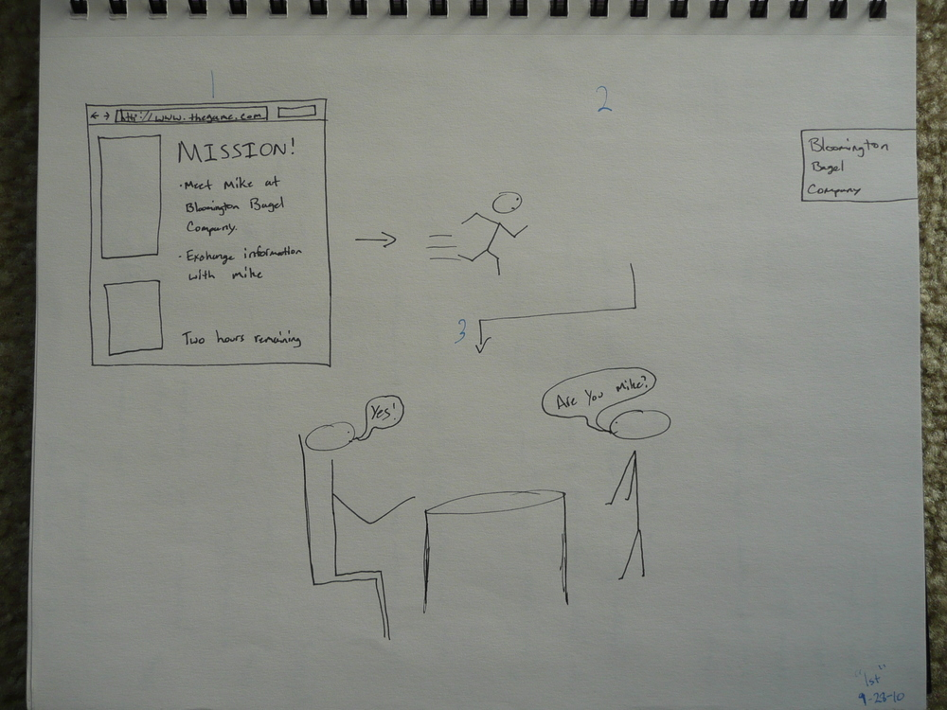
Notes:
To start, here is the first sketch I made. It shows a bigger picture of how I initially imagined the game.
The first sketch! (required by for capstone by Marty at some point last semester)
So I created sketches, imagining how players would go about playing this game in real life.
Image Source: Robert Begley

Slide 31
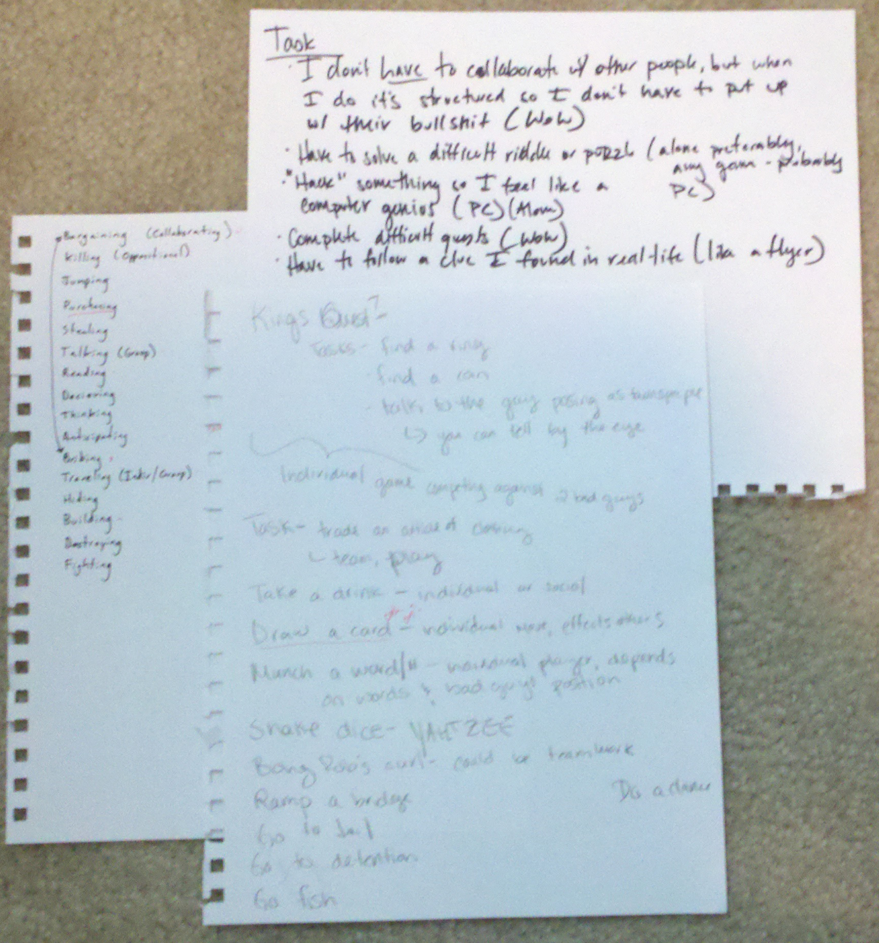
Notes:
Through my concepting I also did some design research, I had participants participate in brainstorming sessions and other activities. In one example I had participants list out tasks that they do already in video games to get an idea of what tasks I might include in my game.
Research: Brainstorming
(OAS: Had participants write down what types of tasks they already do in games and not to limit to just video games, but could be from board games and other types of games)
Image: Robert Begley

Slide 32
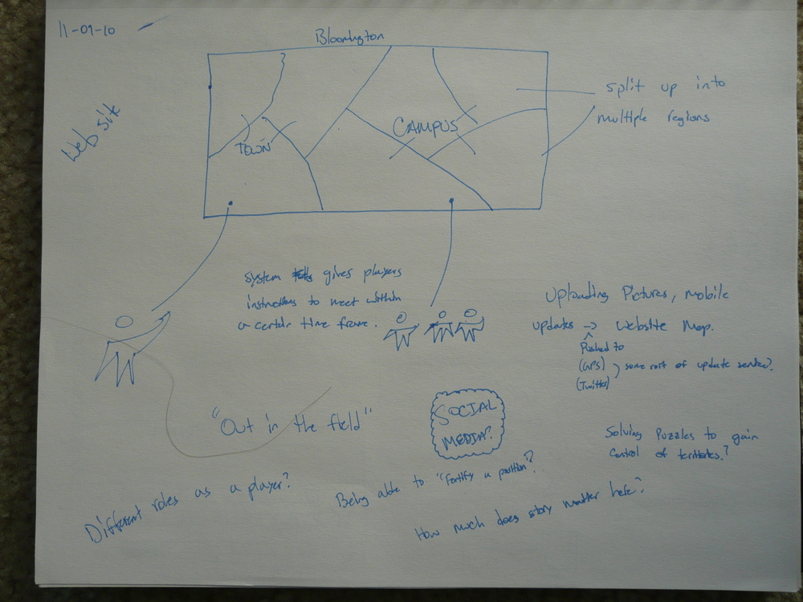
Notes:
One concept involved having players control virtual territory based on tasks done in those physical locations.
Iterated on different concepts of incorporating the physical world into the virtual world.
Image Source: Robert Begley

Slide 33
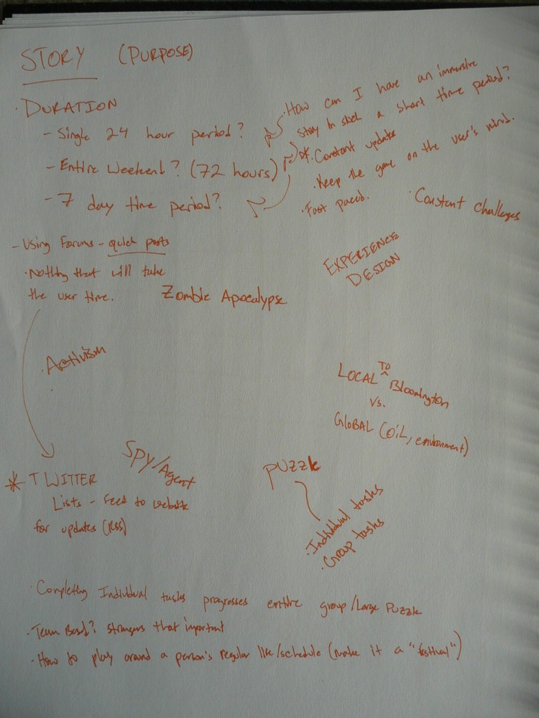
Notes:
I also brainstormed different stories or scenarios that I might want to use. So I looked at things like Activism themes, conspiracy themes, something contextual to Bloomington, and of course a zombie apocalypse theme because everyone loves zombies.
A story is important though, because it gives players a sense of direction. It gives them motivation and end goal.
Image Source: Robert Begley

Slide 34
EvilCorp
Concept Development
Notes:
I finally realized that the core features of the game were going to be contextual to the story of the game.
The scenario I created was to be simple with a clear end goal. A corporation, EvilCorp is looking to hire a single new recruit. Each Player plays the game as a potential candidate with the end goal of winning this position over all the other candidates. And through this I narrowed down 4 major features to be part of the game.
The context of the scenario was going to inform the features of my design.

Slide 35
Candidate Desirability
Concept Development
Notes:
The first page is called “Candidate Desirability”. Now this started out as “Scoreboard” and took many other forms including “player rankings, employee rankings, employee desirability” up until finally “candidate desirability”

Slide 36
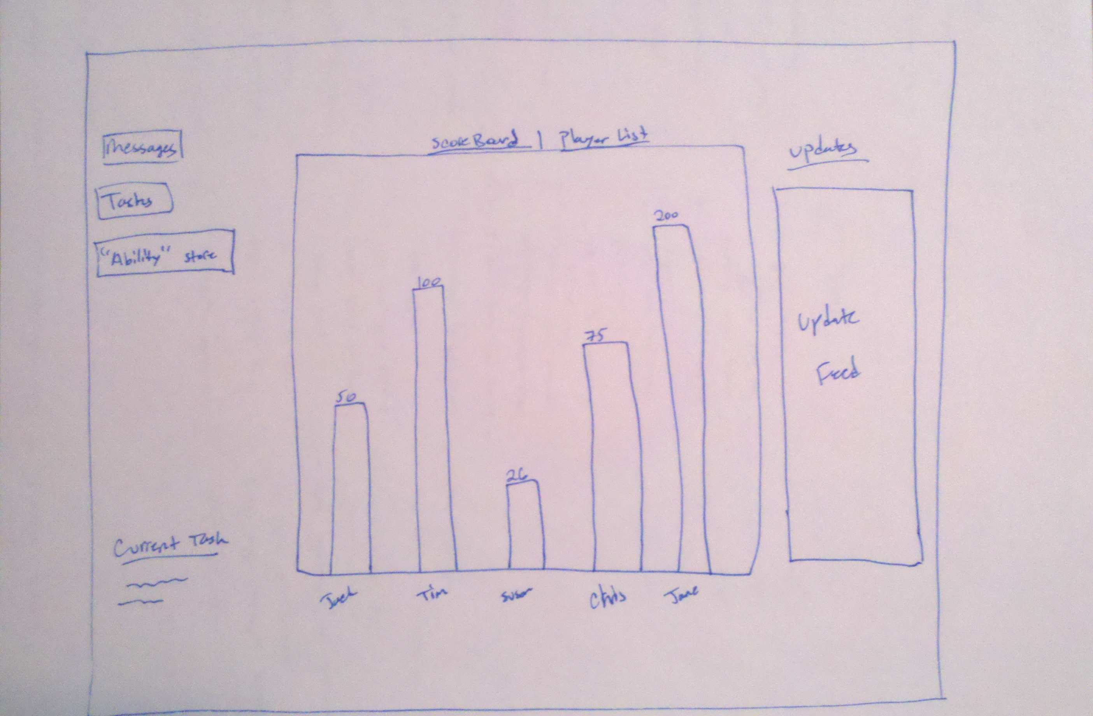
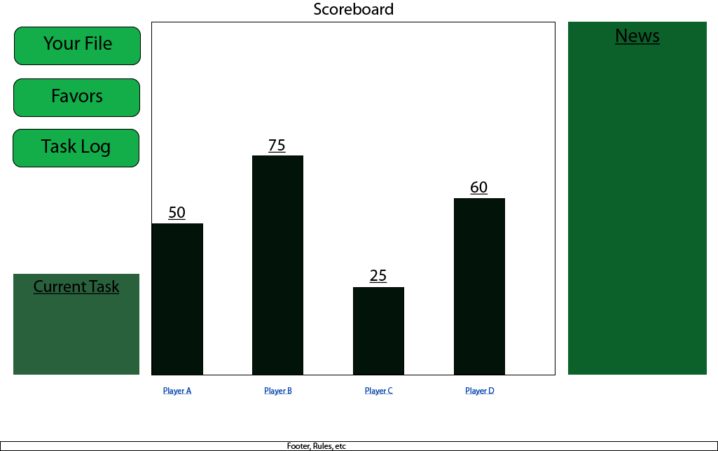
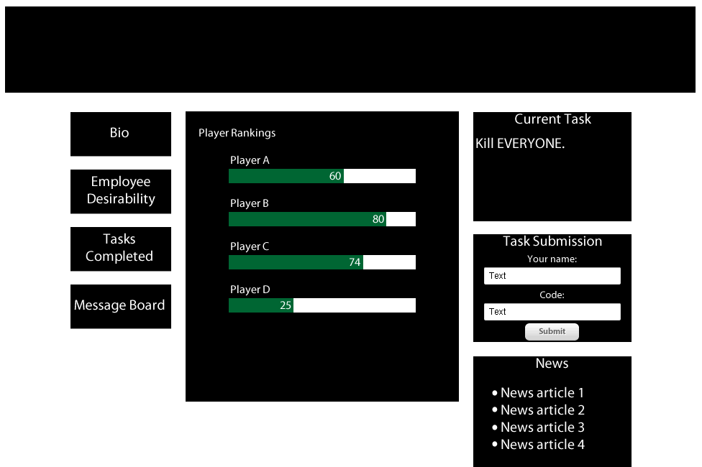
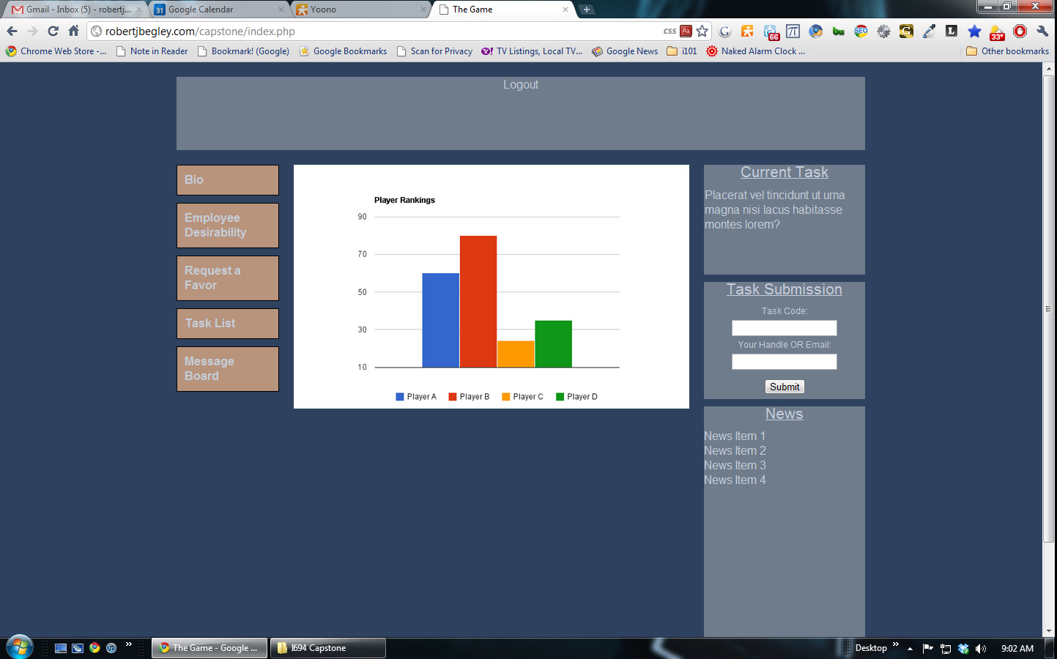
Notes:
Essentially this is a scoreboard ranking players based on their score, or rather how desirable they are to the company. A players desirability increased based on tasks completed.
The first page is called “Candidate Desirability”. Now this started out as “Scoreboard” and took many other forms including “player rankings, employee rankings, employee desirability” up until finally “candidate desirability”.
This created awareness between you and the other players.

Slide 37
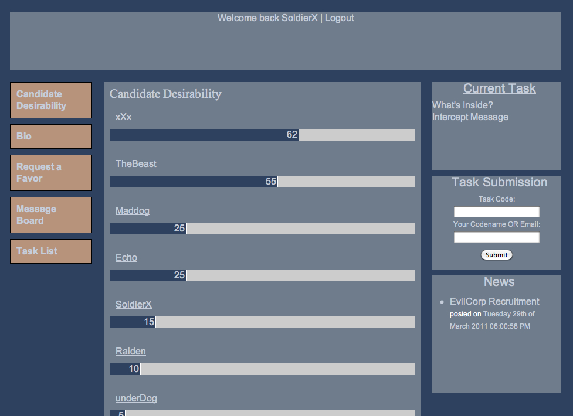
Notes:
This is the final version of the candidate desirability page.

Slide 38
Bio
Concept Development
Notes:
The second page is the “Bio” page. Here players would be able to see their own bio, because players created an avatar, a representation for themselves as part of the game. The bio would contain information that players entered when they registered – they were explicitly told to be creative and have fun with it.

Slide 39
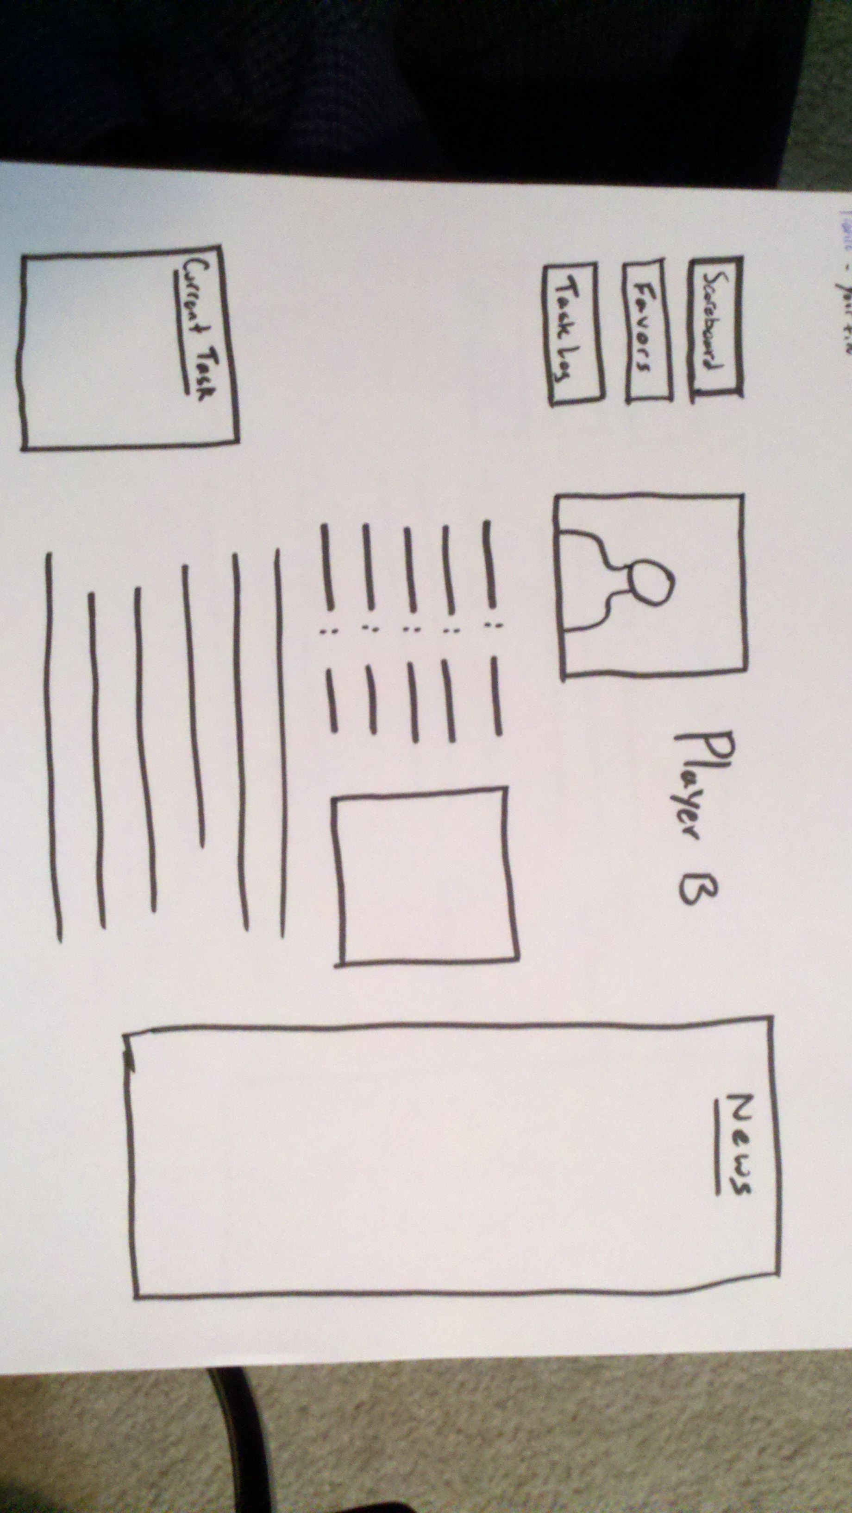
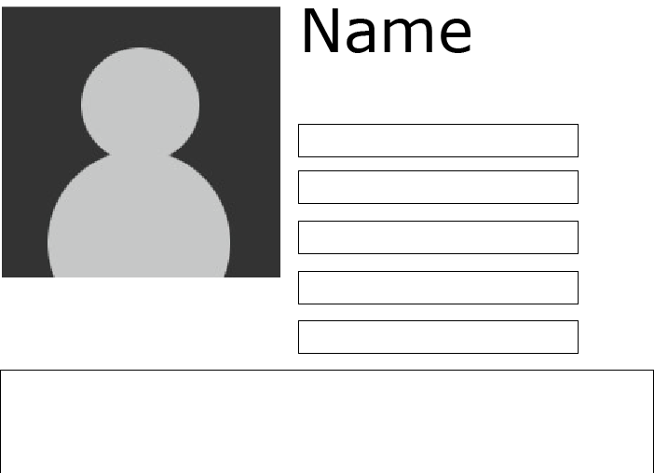
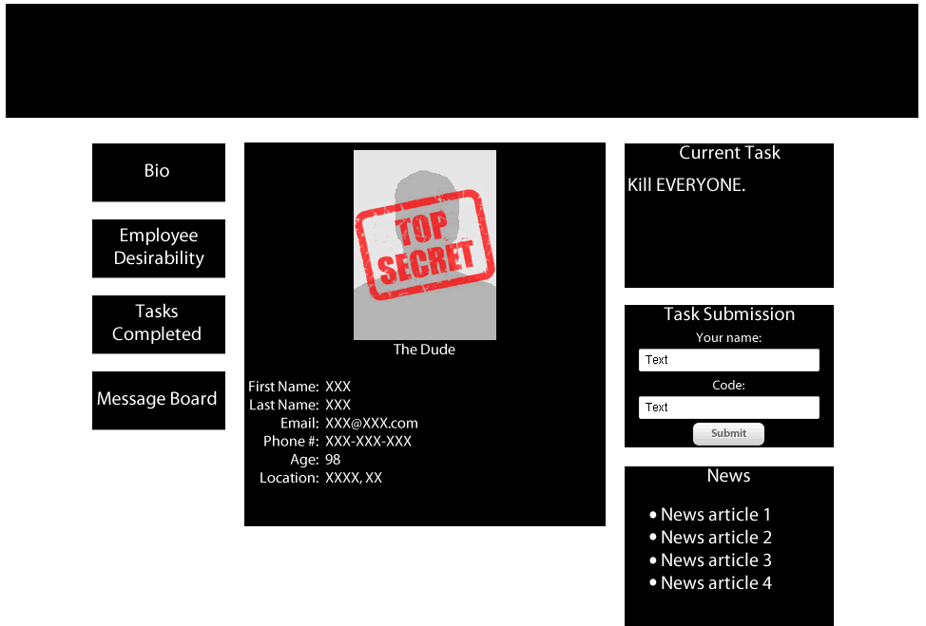
Notes:
Players would be able to see their own bio and possibly their competition’s as well. This allowed for a representation of the player to exist in the virtual world.
The second page is the “Bio” page. Here players would be able to see their own bio, because players created an avatar, a representation for themselves as part of the game. The bio page would contain information that players entered when they registered – they were explicitly told to be creative and have fun with it.

Slide 40
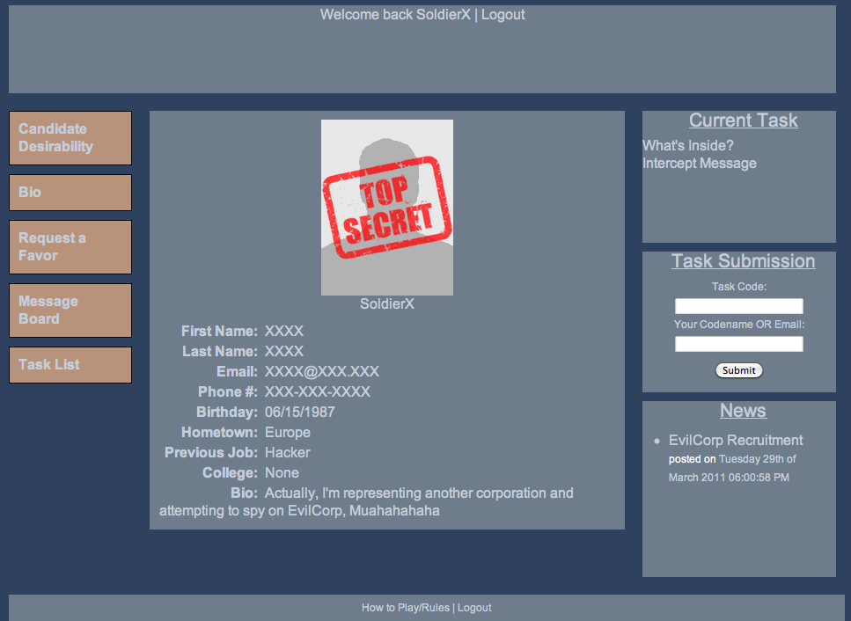
Notes:
The final version of the Bio page.

Slide 41
Request a Favor
Concept Development
Notes:
The third page is the Request a Favor page. This page was created to add an additional dimension to gameplay.
Example?

Slide 42
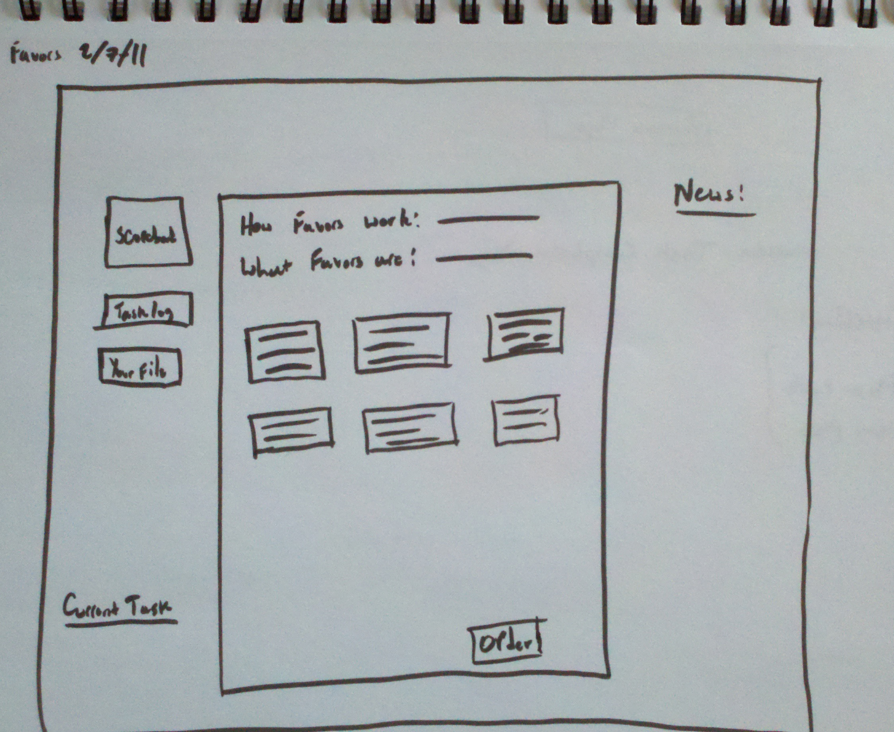
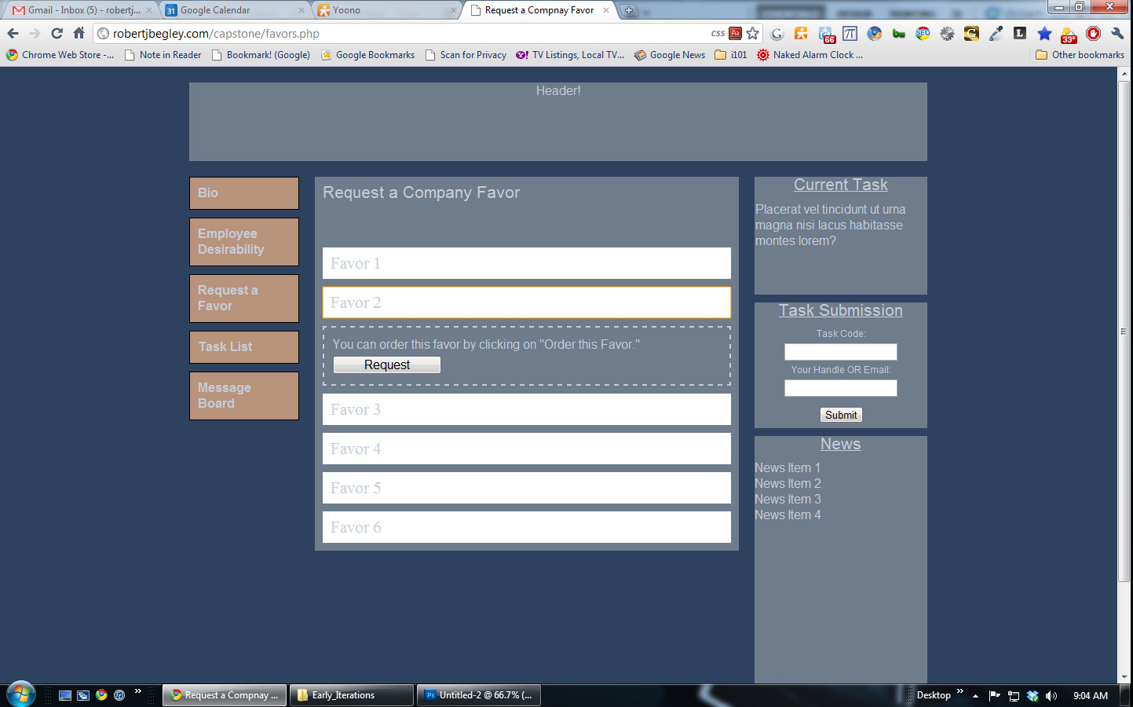
Notes:
This page was created to add an additional dimension to gameplay so that there was more to the game than just completing tasks. Players would be able to “request favors” from the company that would help them as well as being able to ‘sabotage’ other players.
Example?

Slide 43
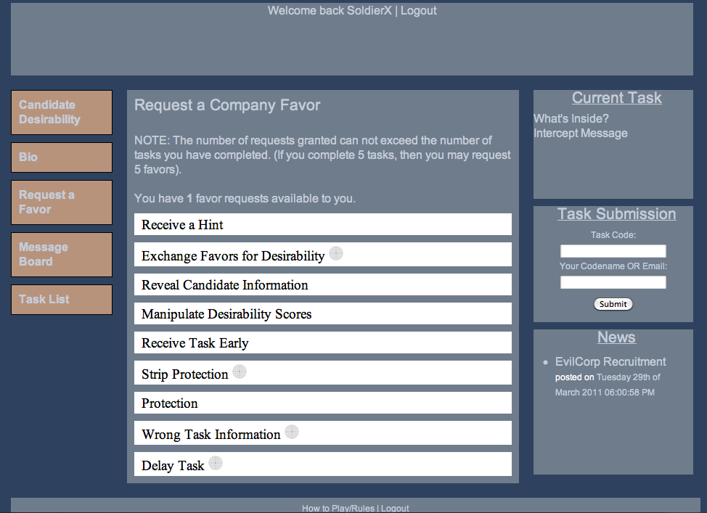
Notes:
Examples of favors are receiving a hint for a challenging task, being able to receive a task earlier than other players, or having the company send out the wrong task information to a targeted player.
The final version of the Request a Favor page.

Slide 44
Message Board
Concept Development
Notes:
The final page is the Message Board page. This allowed players to directly communicate with each other over a common medium.

Slide 45
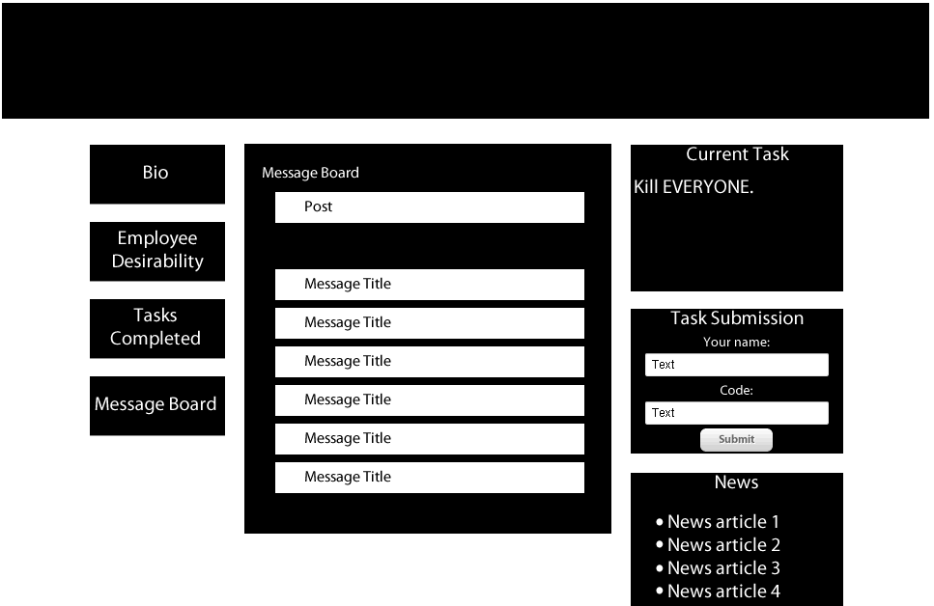
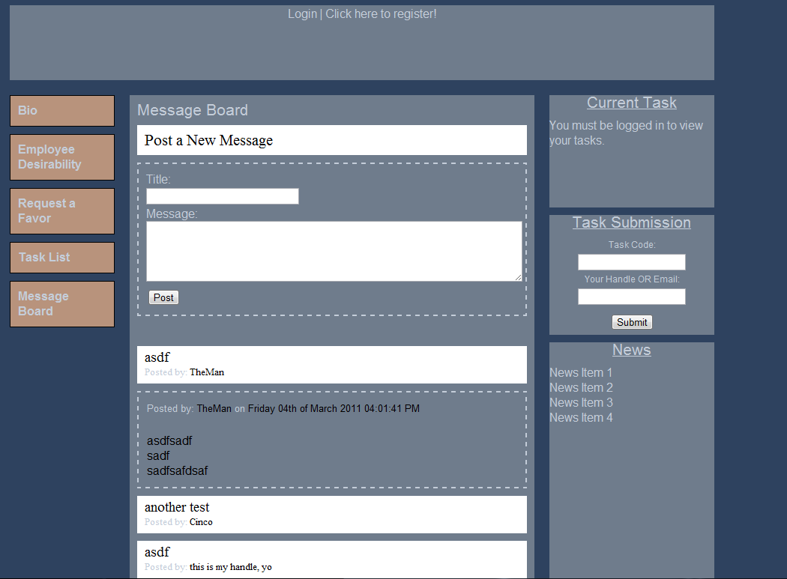
Notes:
The fourth and final core feature is the Message Board page. This allowed players to directly communicate with each other over a shared medium.

Slide 46
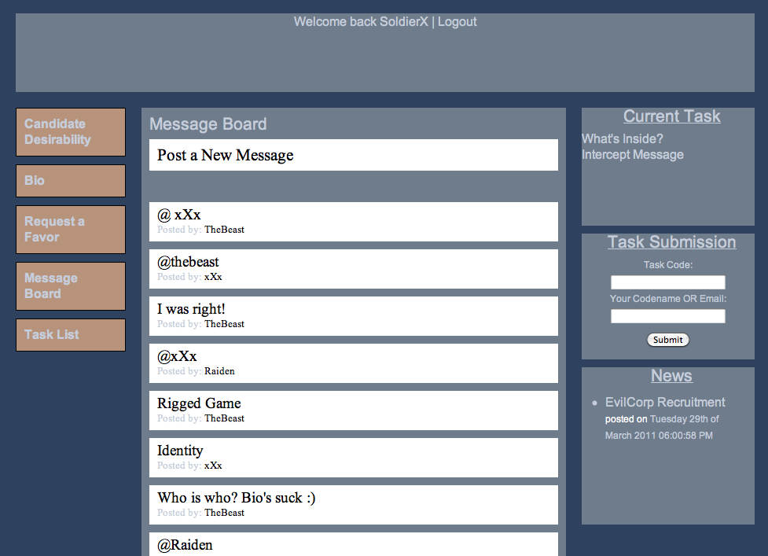
Notes:
It was simple, just with a title and message. Players were told to post whatever they wanted. There were no restrictions.

Slide 47
Final Design
Introduction
Core
Research
Research Insights
Concept Development and Prototypes
Evaluations
Final Redesign
Future Considerations
Reflection
Notes:
I broke down the game into separate parts for evaluation because I didn’t think I was going to have time to evaluate a live game multiple times.
I conducted multiple evaluations on the specific components of the game. I wasn’t going to have time to evaluate a live game multiple times so I broke it down into pieces.

Slide 48
Website Evaluation
Evaluations
Notes:
The first part was testing on the website itself. I was looking to see if players would be able to understand how to navigate the site as well as terms on the site given the context of the game.
The first piece was usability testing on the website, specifically looking at navigation and wording to make sure that players were going to understand how to navigate the site, but also make sure they understand what the terms mean.

Slide 49
Notes:
What I found out was that participants did not have any issues navigating the site, however, NEXT SLIDE
Image Source: Robert Begley

Slide 50
Wording
Insights
Contextual to the game!
Notes:
However, the way navigation was worded was a bit of an issue. I really needed to make sure that the wording on the site made sense given the context of the game.
However, some wording was changed around based on feedback during the evaluations. The wording needed to make sense given the context of the game.

Slide 51
Physical Evaluation
Evaluations
Notes:
The second part was going to be a physical prototype evaluation.

Slide 52
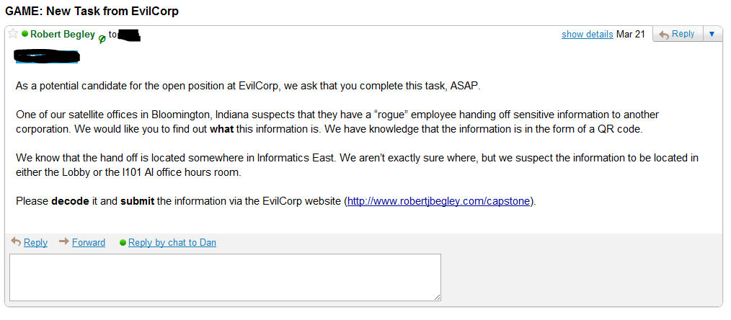
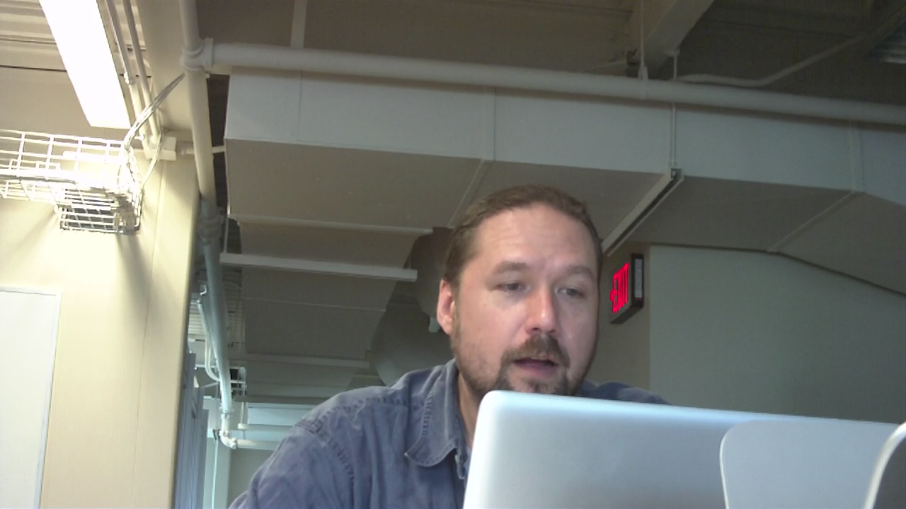
Notes:
In this evaluation a participant was given the task of attempting to find a QR code in a specified location, to decode it, and submit the information via the website.
The participant was given background context to make sure they understood why they were going to be doing what they did. To start out the evaluation, the participant received an email coming from a representative from a company called EvilCorp. They were given two potential locations where they had to find a QR code, decode it, and submit the information via the website.
Initially, the participant was unaware that they would be receiving an email, in fact all I told them is that they would be evaluating a physical prototype. When I sent the email, 8 minutes had passed before the participant saw the email. They were engaged in conversation with another person and I did not want to disrupt this. As part of a live simulation, players would be receiving tasks during times in which they are busy so the fact that they were engaged in something else at first made the evaluation that much more real.
After they read the email and understood what to do, the participant went on to find the QR code. NEXT SLIDE
The moment in which my participant saw the email igniting the evaluation.
The purpose of this evaluation was to have a participant run through a task that might exist in the game done in the physical world.
Participant was tasked with finding, decoding, and submitting information gathered from a QR code.
Image Source: Robert Begley

Slide 53
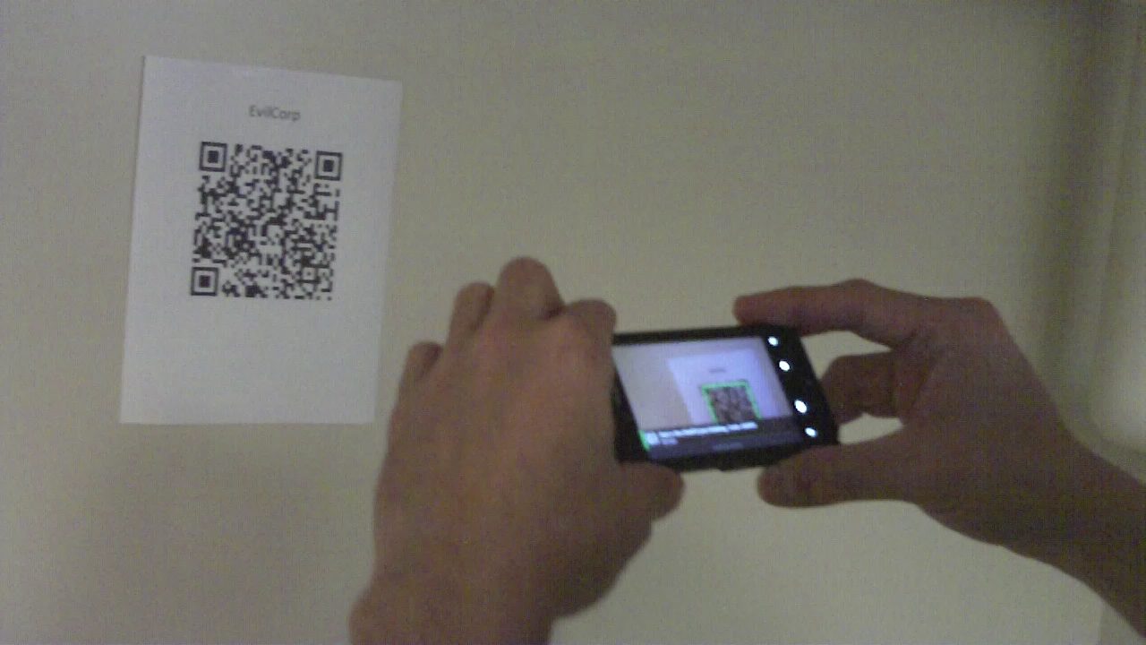
Notes:
So here we have the participant scanning the QR code and... nEXT SLIDE
Here you can see the participant using his phone to scan and decode the QR code as part of the evaluation.
Image Source: Robert Begley

Slide 54
What is a QR code?
Insights
Communicate clearly!
Notes:
One of the major insights for this test was to make sure terms were defined when issuing tasks. So the participant, although knew what a QR code was, raised the question of what if someone doesn’t know what a QR code is. I would need to make players in the game understood what they needed to do in tasks.
Although the participant knew what a QR code was, they raised the question of, what if a player does not know what a QR code is? So, this applies to the game globally, where I would need to be able to provide definitions or additional information, possibly in the form of links to informational websites clarifying any terms that might be foreign to a player.
What is a QR Code? – link to its definition, what it is, etc. (Made me think about its use in the context of training participants)
Which room? (i101 – no such place!) – Participant thought a room titled I101, I meant the I101 office hours room. MUST be careful with communication!
Wanted to go from QR code to submission page on smartphone browser.

Slide 55
Live Game Evaluation
Evaluations
Notes:
After iterating over the design based feedback by the previous evaluations, I then conducted a live game evaluation. I had a total of 9 participants playing the game

Slide 56
Notes:
After iterating over the design based feedback by the previous evaluations, I then conducted a live game evaluation. I had a total of 9 participants playing the game

Slide 57
Notes:
An image showing a player playing the game via the website.
A task chain, by completing the first task, you then open up a new task that is related.

Slide 58
Notes:
In one task players were asked to decode a QR code, however, this task was in a chain of tasks. By completing this task, players would be open up to another task. So the QR code had a link embedded in it where players would go to, to find the next thing they had to do.

Slide 59
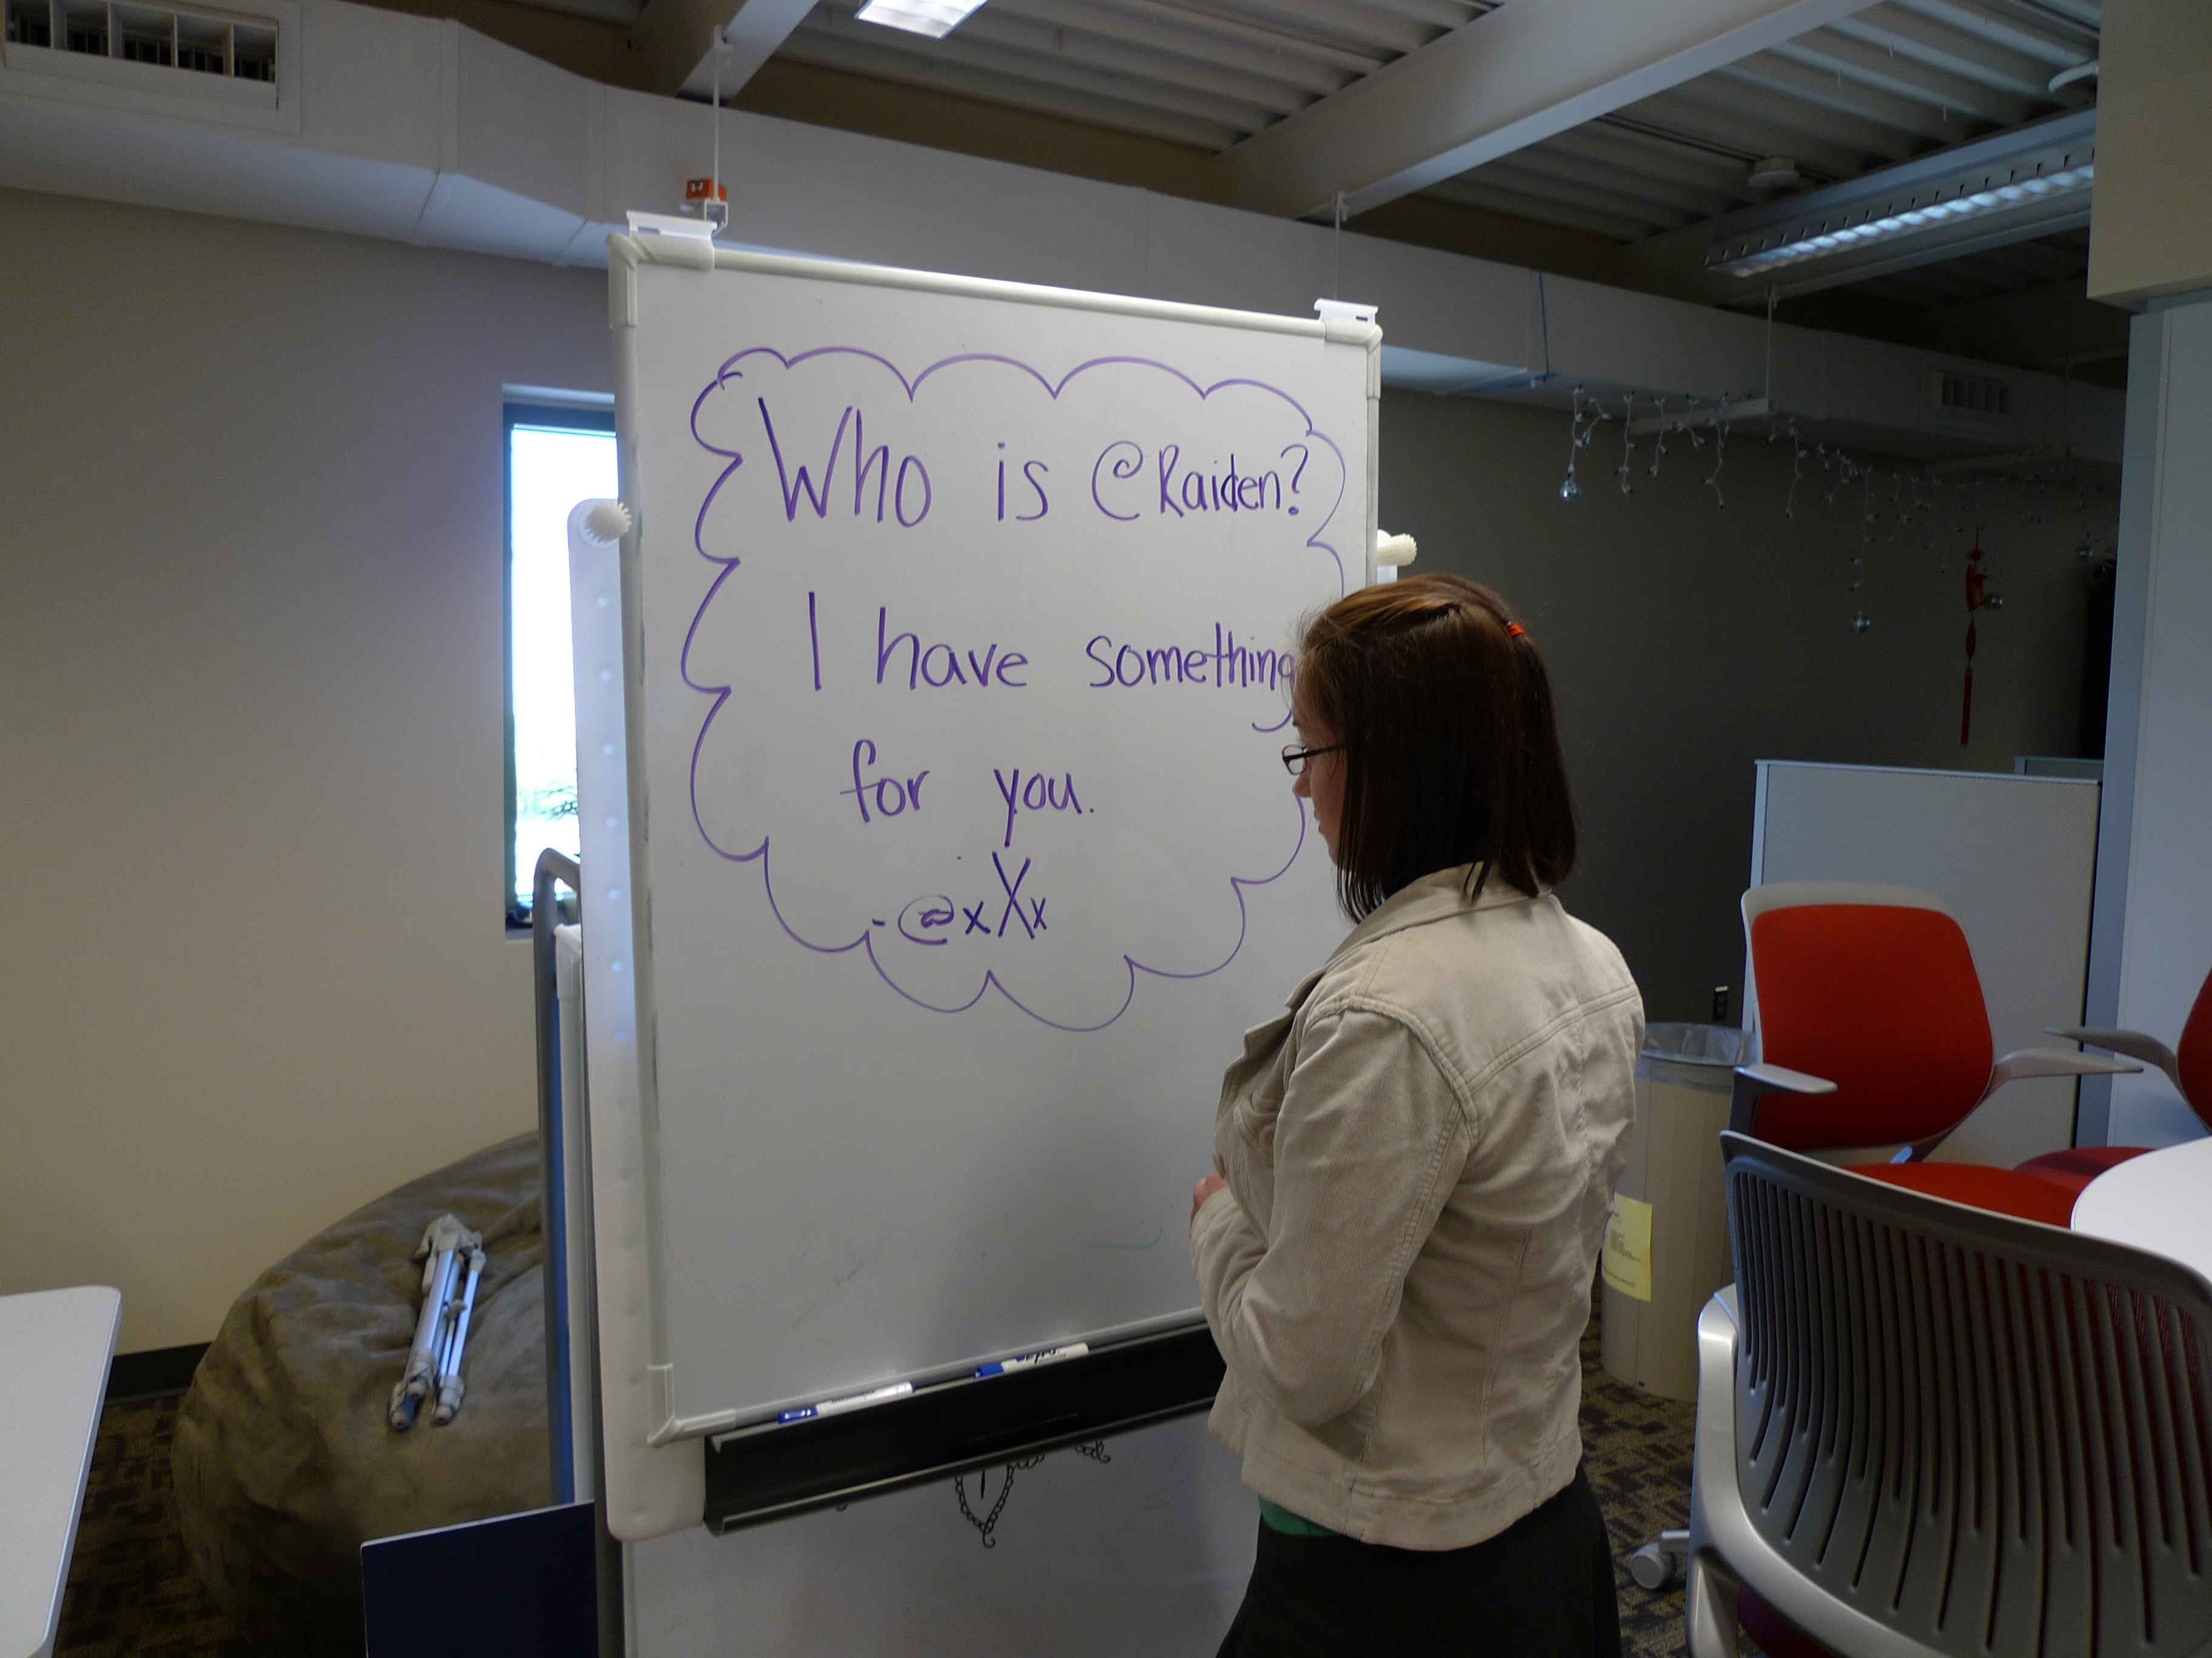
Notes:
In another task, players had to exchange information with one another by any means. This image shows one player attempting to establish communication with another player by using a whiteboard hoping that the other player spends time in this space, which they ended up doing and so those players were able to meet up and exchange information. This was really cool because players took the game in their own hands to complete the task.
SHOW VIDEO
This is great, this is totally emergent behavior that a player is showing.

Slide 60
Final Design
Introduction
Core
Research
Research Insights
Concept Development and Prototypes
Evaluations
Final Redesign
Future Considerations
Reflection
Notes:
Based off the feedback I received, I made a few changes.

Slide 61
“Slow response time to validate codes. I would have wanted an automated code validator after submission, so I could know if something counted right away.”
Final Redesign
Notes:
“Overall I like the idea of the game. Good job!”
“Thanks for the game, it was fun!”
When asked about the participants least favorite part of the game:
“It seemed too complicated and would take up too much time.”
“Slow response time to validate codes. I would have wanted an automated code validator after submission, so I could know if something counted right away.”
“Figuring minor things out was a bit of a hassle because i have my own to do list - didnt really want to sit and try to find things on the site”
When asked about participants favorite part of the game:
“I liked the task where we had to find an image in the basement of INFO-E. There's something about physically searching for an item that makes the game more exciting.”
“the variety of challenges."
“socialization”

Slide 62
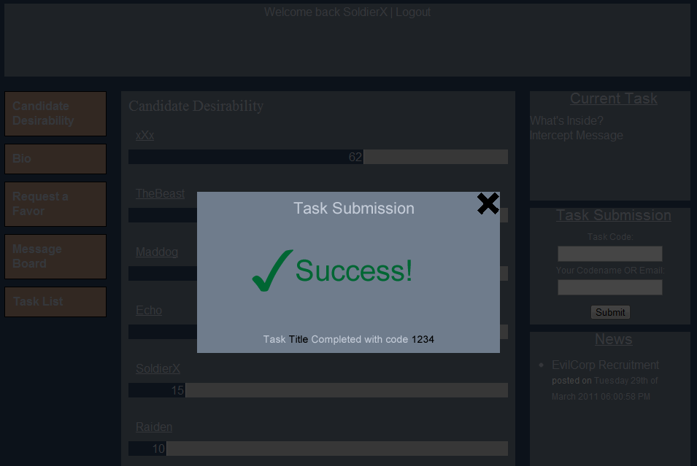
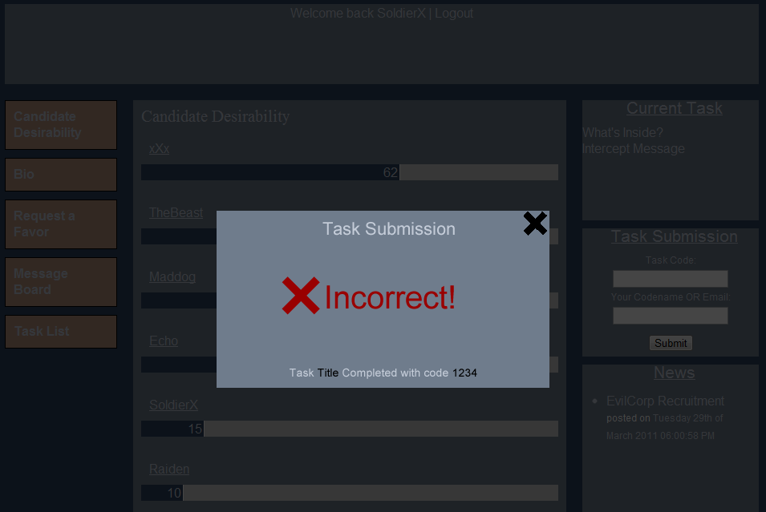
Notes:
One of the most important pieces of feedback was for the tasks to be automatically validated.
Players wanted immediate feedback when they submitted a task.
Image Source: Robert Begley

Slide 63
“Blogging out information instead of sending emails."
Final Redesign
Notes:
This particular response was from being asked “what their favorite part of the game was”

Slide 64
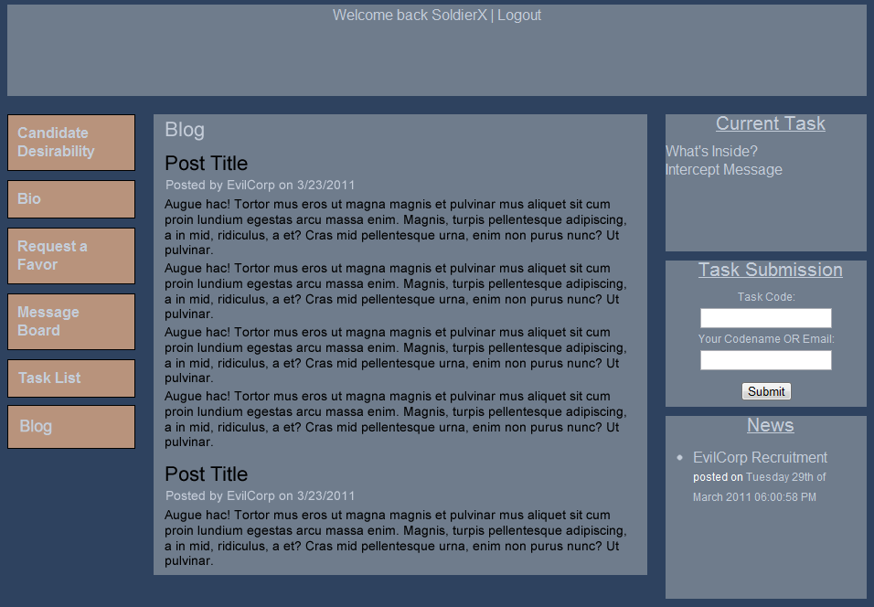
Notes:
More use of multiple mediums for communication, blogs, texting, etc. This was particular in response to using email because participants already have their email boxes full from other stuff.
Image Source: Robert Begley

Slide 65
“I would like to be able to reply to a message.”
Final Redesign
Notes:
This particular response was from being asked “what their favorite part of the game was”

Slide 66
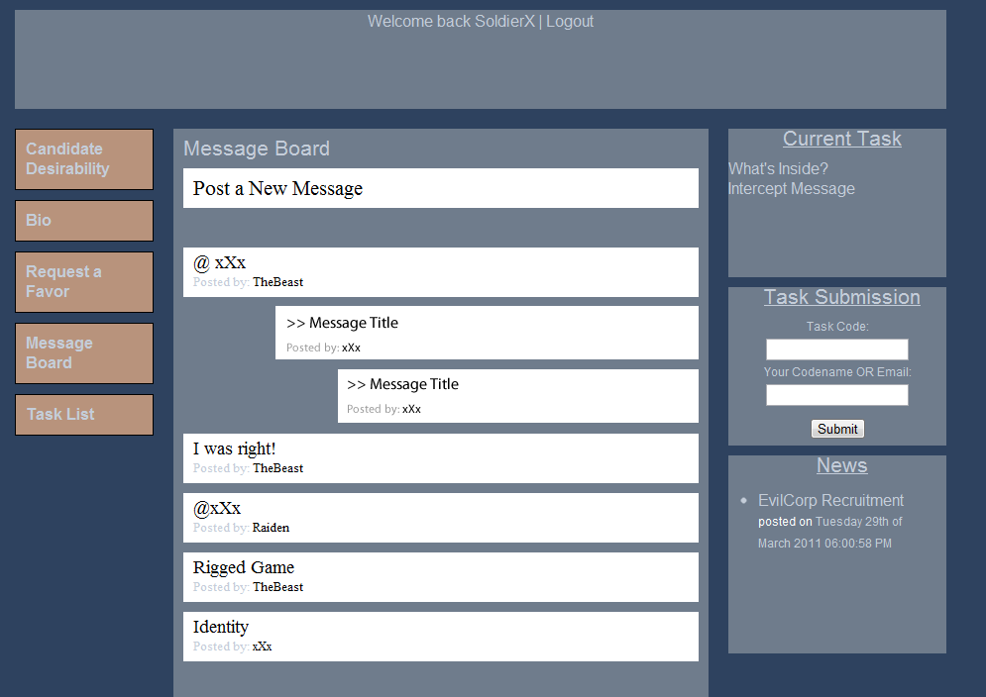
Notes:
Being able to reply on the message board for more direct communication. This redesign came more so of how I observed players using the message board more so than it did from direct feedback.
Image Source: Robert Begley

Slide 67
Final Design
Introduction
Core
Research
Research Insights
Concept Development and Prototypes
Evaluations
Final Redesign
Future Considerations
Reflection
Notes:
After running through this process, I started to reflect on where to go from here, what now? So I started thinking about alternate reality games as a tool to be applied to different situations.

Slide 68
Learning
Future Considerations
Kids and Education, Training
Notes:
One situation might be learning, so kids and education as well as training employees in a business. Doing it through the context of an alternate reality game may provide additional motivation in a learning environment.
Learning, where learning is achieved in the context of an alternate reality game. So kids and education might be an interesting area to look at as well as training employees in a business.

Slide 69
Community
Future Considerations
Exploring, meeting new people
Notes:
Another area was using alternate reality games to explore a new city you might have moved to as well as meeting new people. The ARG provides common ground for people that might make meeting new people an easier task.
Using alternate reality games to explore a new city you might have moved to or to further explore a community you already live in, but also it provides common ground amongst the people playing the game which may make it easier to meet new people because of a shared context.

Slide 70
Work Distribution
Future Considerations
Notes:
Finally, alternate reality games could be seen as a platform for distributed work.
Finally, Work Distribution. An ARG could be used as a potential tool to spread massive amounts of work to a large user base. Much like distributed computing projects.

Slide 71
Final Design
Introduction
Core
Research
Research Insights
Concept Development and Prototypes
Evaluations
Final Redesign
Future Considerations
Reflection
Notes:
Reflection.

Slide 72
Reflection
Share your work!
Notes:
Reflecting on this project, I learned and realized that although it was an individual project, I was still constantly sharing my work with others. Always looking for new perspectives, critique, and general feedback. Ultimately it is important to be sharing your work with others throughout your design process.
Even though the capstone project was individual, it is still important to share your work, especially at all stages of design. Continually receive feedback, receive new perspectives, talk about it. Even though it was individual, I still found myself working with others whether through receiving critique, usability testing, brainstorming or some other activity.
What did I learn? About the project itself? Designing something on own?
Designing by yourself can be really nice. Full control over the design. However, designing in a team you become much more accountable and it can be easier to share and receive instant feedback on any work you have done.
Capstone Specific: It can be really difficult to stick to your ‘core’. Although, it is certainly OKAY to change your core, you can easily run through many iterations that may make you lose track of your core. Basically, any project you work on is continously changing.
Opportunity Space vs. Problem Space: Looking back, I’m very glad that I didn’t focus on a specific problem to solve, but rather took a an already existing area and explored it using the methods, tools, resources I’ve learned about as an HCI designer. This is very different than picking out a problem with an already existing interaction and iterating solutions on it. This is important to note.

Slide 73
Reflection
“Opportunity Space” and “Problem Space”
Notes:
Reflecting on this project and as a thought contribution to the field of HCI, I think that it is important to look at the way we label our approach to design problems. I believe that the terms Problem Space and Opportunity Space are very different. In one you are identifying a flaw or issue in a design space, iterating over it to find solutions, and in the other you are looking to explore a space to think about what else can we do in this space using resources, tools, and methods from HCI.
Reflecting on this project, and as a contribution to the field of HCI, I think the way we label our design work is important and gives different meaning. I think that problem space and opporutnity space really mean different things, where in one you are identifying a flaw or issue in a design and iterating over it to find solutions and in the other you are looking to explore a field or space using resources, tools, and methods from HCI where a problem may not necessarily exist.
The idea behind an “Opportunity Space” and a “Problem Space”. Some think they mean the same thing, I don’t. I think, as a contribution to HCI as a whole, that by labeling something an opportunity space or a problem space that they force two different views. In one you are looking for a problem to iterate over to find solutions. In the other, you are looking to explore a space using methods, tools, and resources from an HCI perspective. FIX THIS.
Some people see these terms as similar. That is you can phrase a problem space as an opportunity space. However, I think they are fundamentally different. I think given the term of ‘problem space’ we naturally will want to find problems given the context of the ‘space’. Where as an ‘opportunity space’ we take a field and explore it. Not necessarily trying to find a problem to fix, but rather to take an already existing area and explore it using methods, tools, and resources coming from an HCI perspective.
I also see this as a thought contribution to HCI as a whole. It isn’t always necessary to start with a specific problem to solve. It is okay to step back, explore a field through research and see what you can do differently. The approach can be different than picking out an already existing interaction and iterating solutions on it.

Slide 74
Reflection
Digital Technology isn’t always the answer!
Notes:
One final piece of reflection as well as a thought contribution to Hci, I think we as designers need to keep in mind that analog artifacts provide a different and unique experience than digital artifacts and even combining both can provide an enjoyable and useful experience.
One final reflection, Another contribution for the field of HCI: IXD and UX does not need to be solely on a screen AND it certainly doesn’t need to be digital. Analog and digital artifacts can be used in combination with one another in order to create something that people find enjoyable and useful. I think that HCI as a whole should draw from this mixed medium approach, gaming as an innovative and unique way to think outside the box, and adapt strategies for problem solving.

Slide 75
Thank you!
Notes:
Thank you to the participants who played the game, ran through the other evaluations, the participants that let me interview them, and everyone who supported and helped me throughout this project. Thank you.

Slide 76
Works Cited
Bardzell, Jeffrey, Shaowen Bardzell, Craig Birchler, and Will Ryan. "Double Dribble: Illusionism, Mixed Reality, and the Sports Fan Experience." ACM (2007).
Drascic, David., Milgram, Paul. “Perceptual Issues in Augmented Reality.” Proc. SPIE Vol. 2653: Stereoscopic Displays and Virtual Reality Systems III. 1996.
Eagle Eye Free Fall. http://www.eagleeyefreefall.com/.
Jane McGonigal. “Gaming can make a better world”. Video. http://avantgame.com/.
Jarvenpaa, Sirkka, and Dorothy E. Leidner. "Jarvenpaa & Leidner: Communication and Trust in Global Virtual Teams." ORGANIZATION SCIENCE (1999).
Judith, Olson S., Stephanie Teasley, Lisa Covi, and Gary Olson. The (Currently) Unique Advantages of Collocated Work. MIT Press. Web. Nov. 2010.
McCarthy, John, and Peter Wright. Technology as Experience. MIT, 2004.
Reality Game X. http://realitygamex.blogspot.com/.

Slide 77
Trust
“... ’swift’ trust for temporary teams whose existence, like those of global virtual teams, is formed around a common task with a finite life span” (Jarvenpaa & Leidner, 794).
Notes:
I explored trust because of the relevance it was going to have in the game. Players may or may not be competing with each other and possibly having to work together to accomplish a common goal, but in the end their might only be one winner.

Slide 82
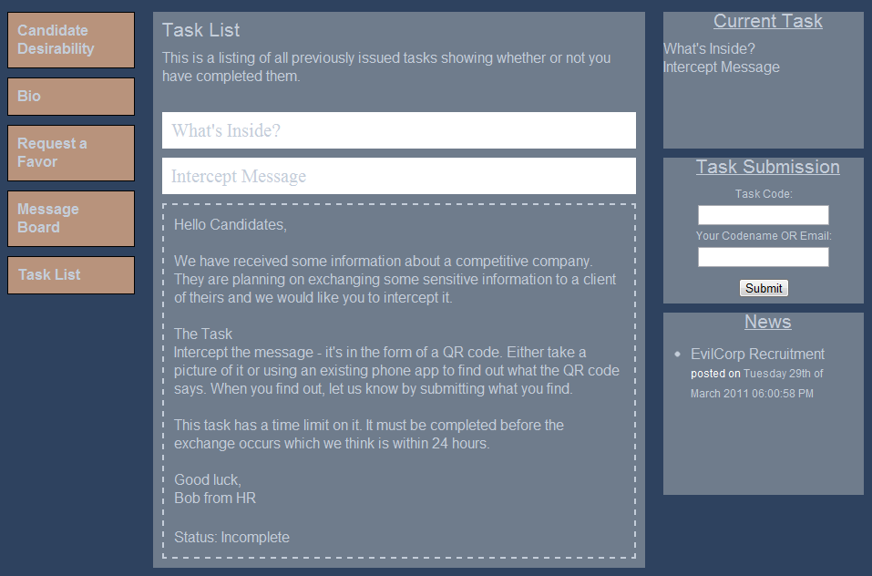

Slide 83
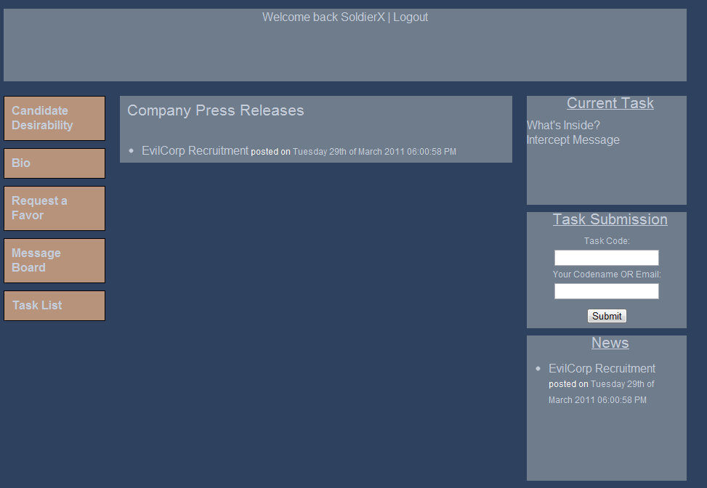

Slide 84
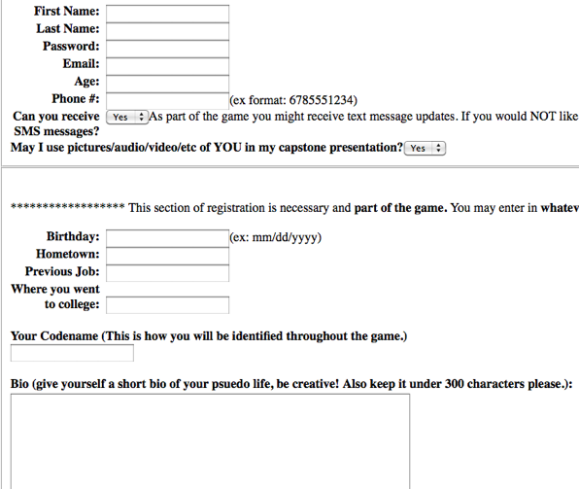

Slide 85
“Overall I like the idea of the game. Good job!”
Evaluations Insights
“Thanks for the game, it was fun!”
Notes:
After the game ended, I asked the participants to complete a survey and also interviewed a couple of them. These are some of their responses.

Slide 86
Experience Design
Research
Notes:
Dewey experience as fullfillment, something seen all the way through.
“We have an experience when the material experienced runs its course to fulfillment.”
McCarthy & Wright. “Technology as Experience”. 2004. MIT Press. Page 102.

Slide 87
Mixed Reality
Research
“... combines a virtual world and streaming audiocast of a NBA or NCAA game to create an experience that blends both realities” (Bardzell et al).
Notes:
One exemplar is where Bardzell et al created a mixed reality game combining a virtual world and streaming audiocast of a sports game. NEXT SLIDE.
I also looked at research focusing on mixed reality, because of how similarly related it is to what Alternate reality games are.
One example of this is a design called Double Dribble, where the researchers <Read quote>
So I looked at mixed reality research as a way to help inform my own design.

Slide 88
Motivation
Insights
Notes:
One of the questions I asked participants was “What would entice you to play this type of game”? Responses varied, but participants would want to see progress, so much like how you can see progress in games like world of warcraft where its dependent on your character level and your gear. Participants also would want to get out in the real world, this was something that was attractive to them because it offers something that is different and unique.

Slide 89
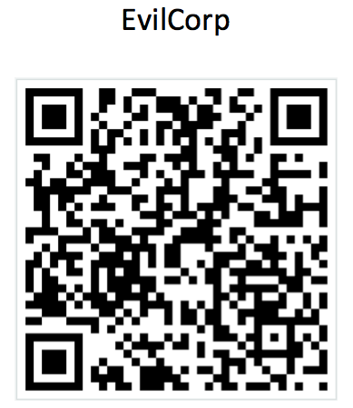
Notes:
This was what he was looking for. The participant did not find it right away, in fact in one of the specified locations were posters containing QR codes unrelated to the evaluation, however, the participant went on to scan those QR codes just in case it was part of the evaluation. They eventually decided that was not the correct code they were looking for and eventually found the correct one. NEXT SLIDE.
Image Source: Robert Begley

Slide 90
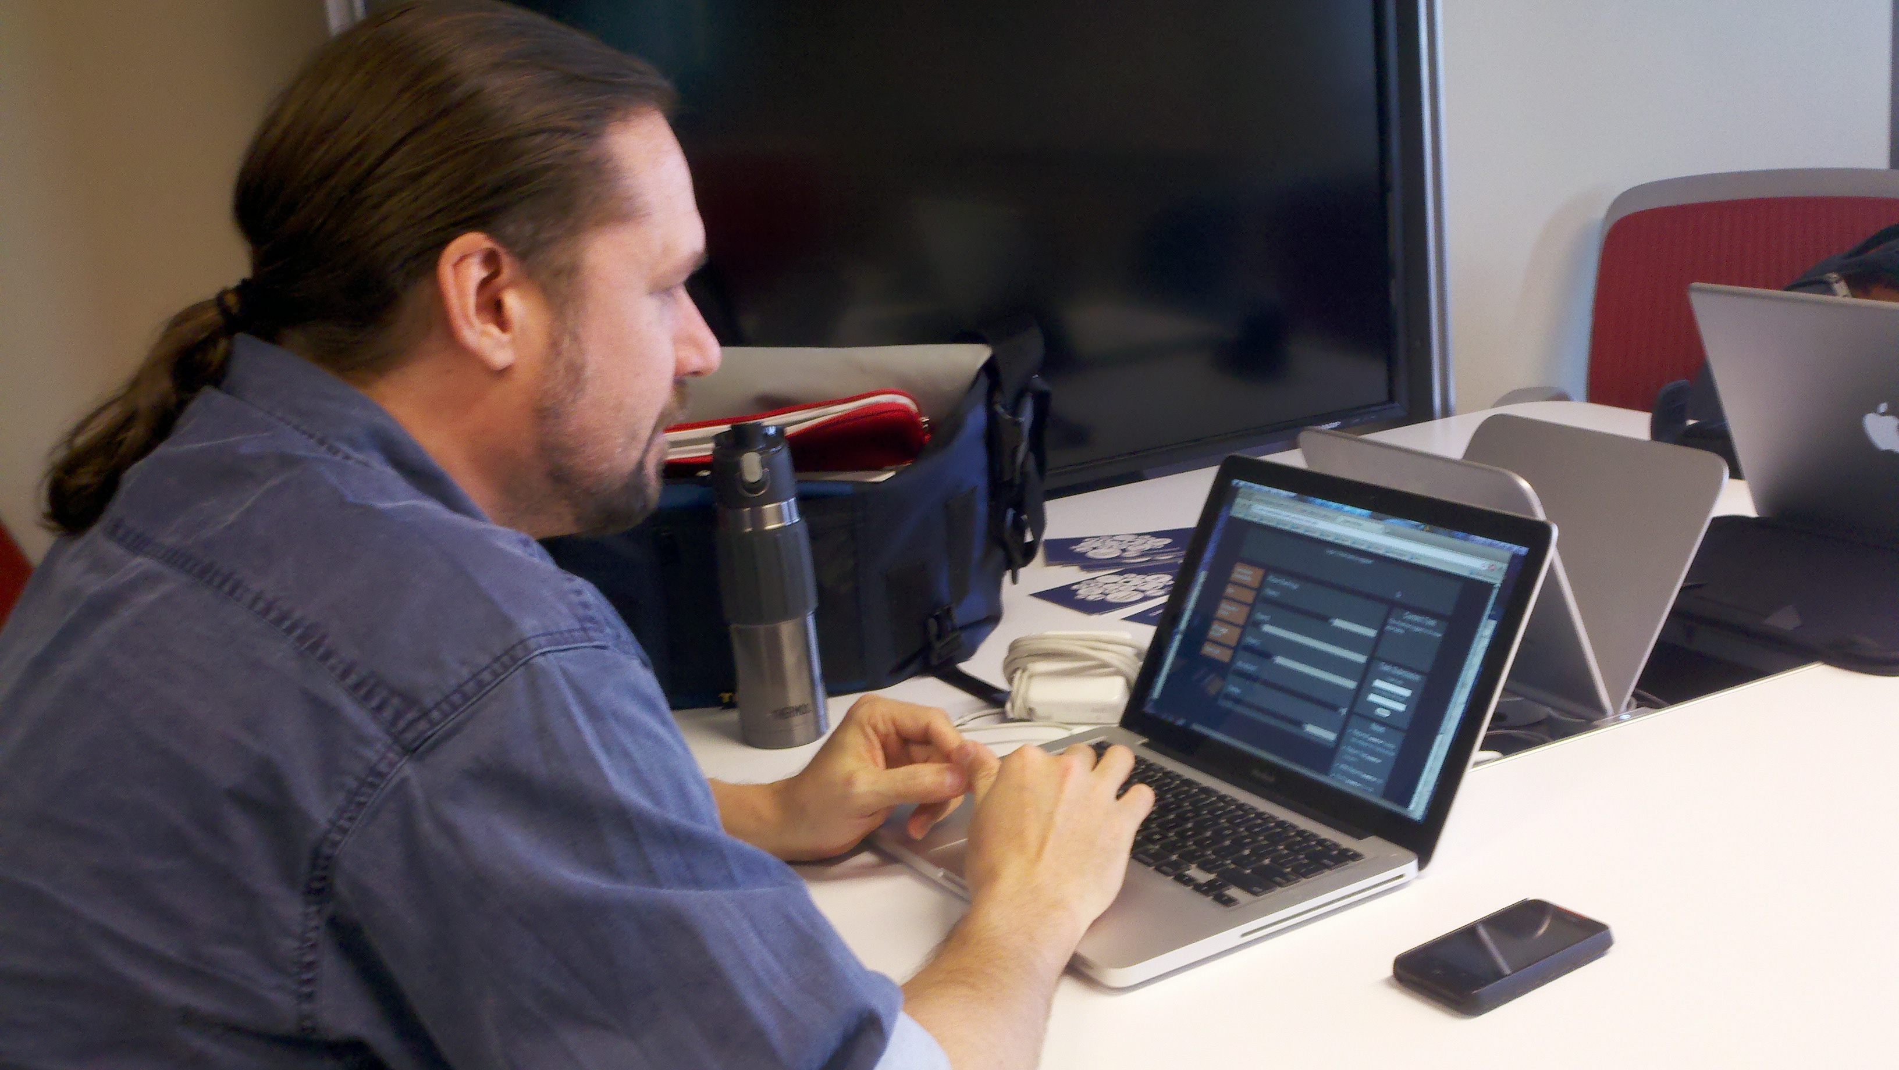
Notes:
... And submitting the information via the website. NEXT SLIDE.
Image Source: Robert Begley

Slide 91
What is a QR code?
Insights
Define non common knowledge terms!
Notes:
One of the major insights for this test was to make sure terms were defined when issuing tasks. So the participant, although knew what a QR code was, raised the question of what if someone doesn’t know what a QR code is. I would need to make players in the game understood what they needed to do in tasks.
Although the participant knew what a QR code was, they raised the question of, what if a player does not know what a QR code is? So, this applies to the game globally, where I would need to be able to provide definitions or additional information, possibly in the form of links to informational websites clarifying any terms that might be foreign to a player.
What is a QR Code? – link to its definition, what it is, etc. (Made me think about its use in the context of training participants)
Which room? (i101 – no such place!) – Participant thought a room titled I101, I meant the I101 office hours room. MUST be careful with communication!
Wanted to go from QR code to submission page on smartphone browser.

Slide 92
Where is this location?
Insights
Communicate clearly!
Notes:
Another insight was, the participant becoming confused about one of the locations. In the email sent with the instructions the room was designated as the “i101 office hours” room, however, the participant interpreted this as room I101. The participant, did see a sign stating “i101 office hours”, but this was important and made me realize that I need to really clarify information and tasks that are sent out to players. So communicate clearly!
What is a QR Code? – link to its definition, what it is, etc. (Made me think about its use in the context of training participants)
Which room? (i101 – no such place!) – Participant thought a room titled I101, I meant the I101 office hours room. MUST be careful with communication!
Wanted to go from QR code to submission page on smartphone browser.

Slide 93
“Figuring minor things out was a bit of a hassle because I have my own to do list – didn’t really want to sit and try to find things on the site.”
Evaluation Feedback
Notes:
“Overall I like the idea of the game. Good job!”
“Thanks for the game, it was fun!”
When asked about the participants least favorite part of the game:
“It seemed too complicated and would take up too much time.”
“Slow response time to validate codes. I would have wanted an automated code validator after submission, so I could know if something counted right away.”
“Figuring minor things out was a bit of a hassle because i have my own to do list - didnt really want to sit and try to find things on the site”
When asked about participants favorite part of the game:
“I liked the task where we had to find an image in the basement of INFO-E. There's something about physically searching for an item that makes the game more exciting.”
“the variety of challenges."
“socialization”

Slide 94
Task List
Concept Development
Notes:
The fourth page is the Task List page. This page allowed players

Slide 95
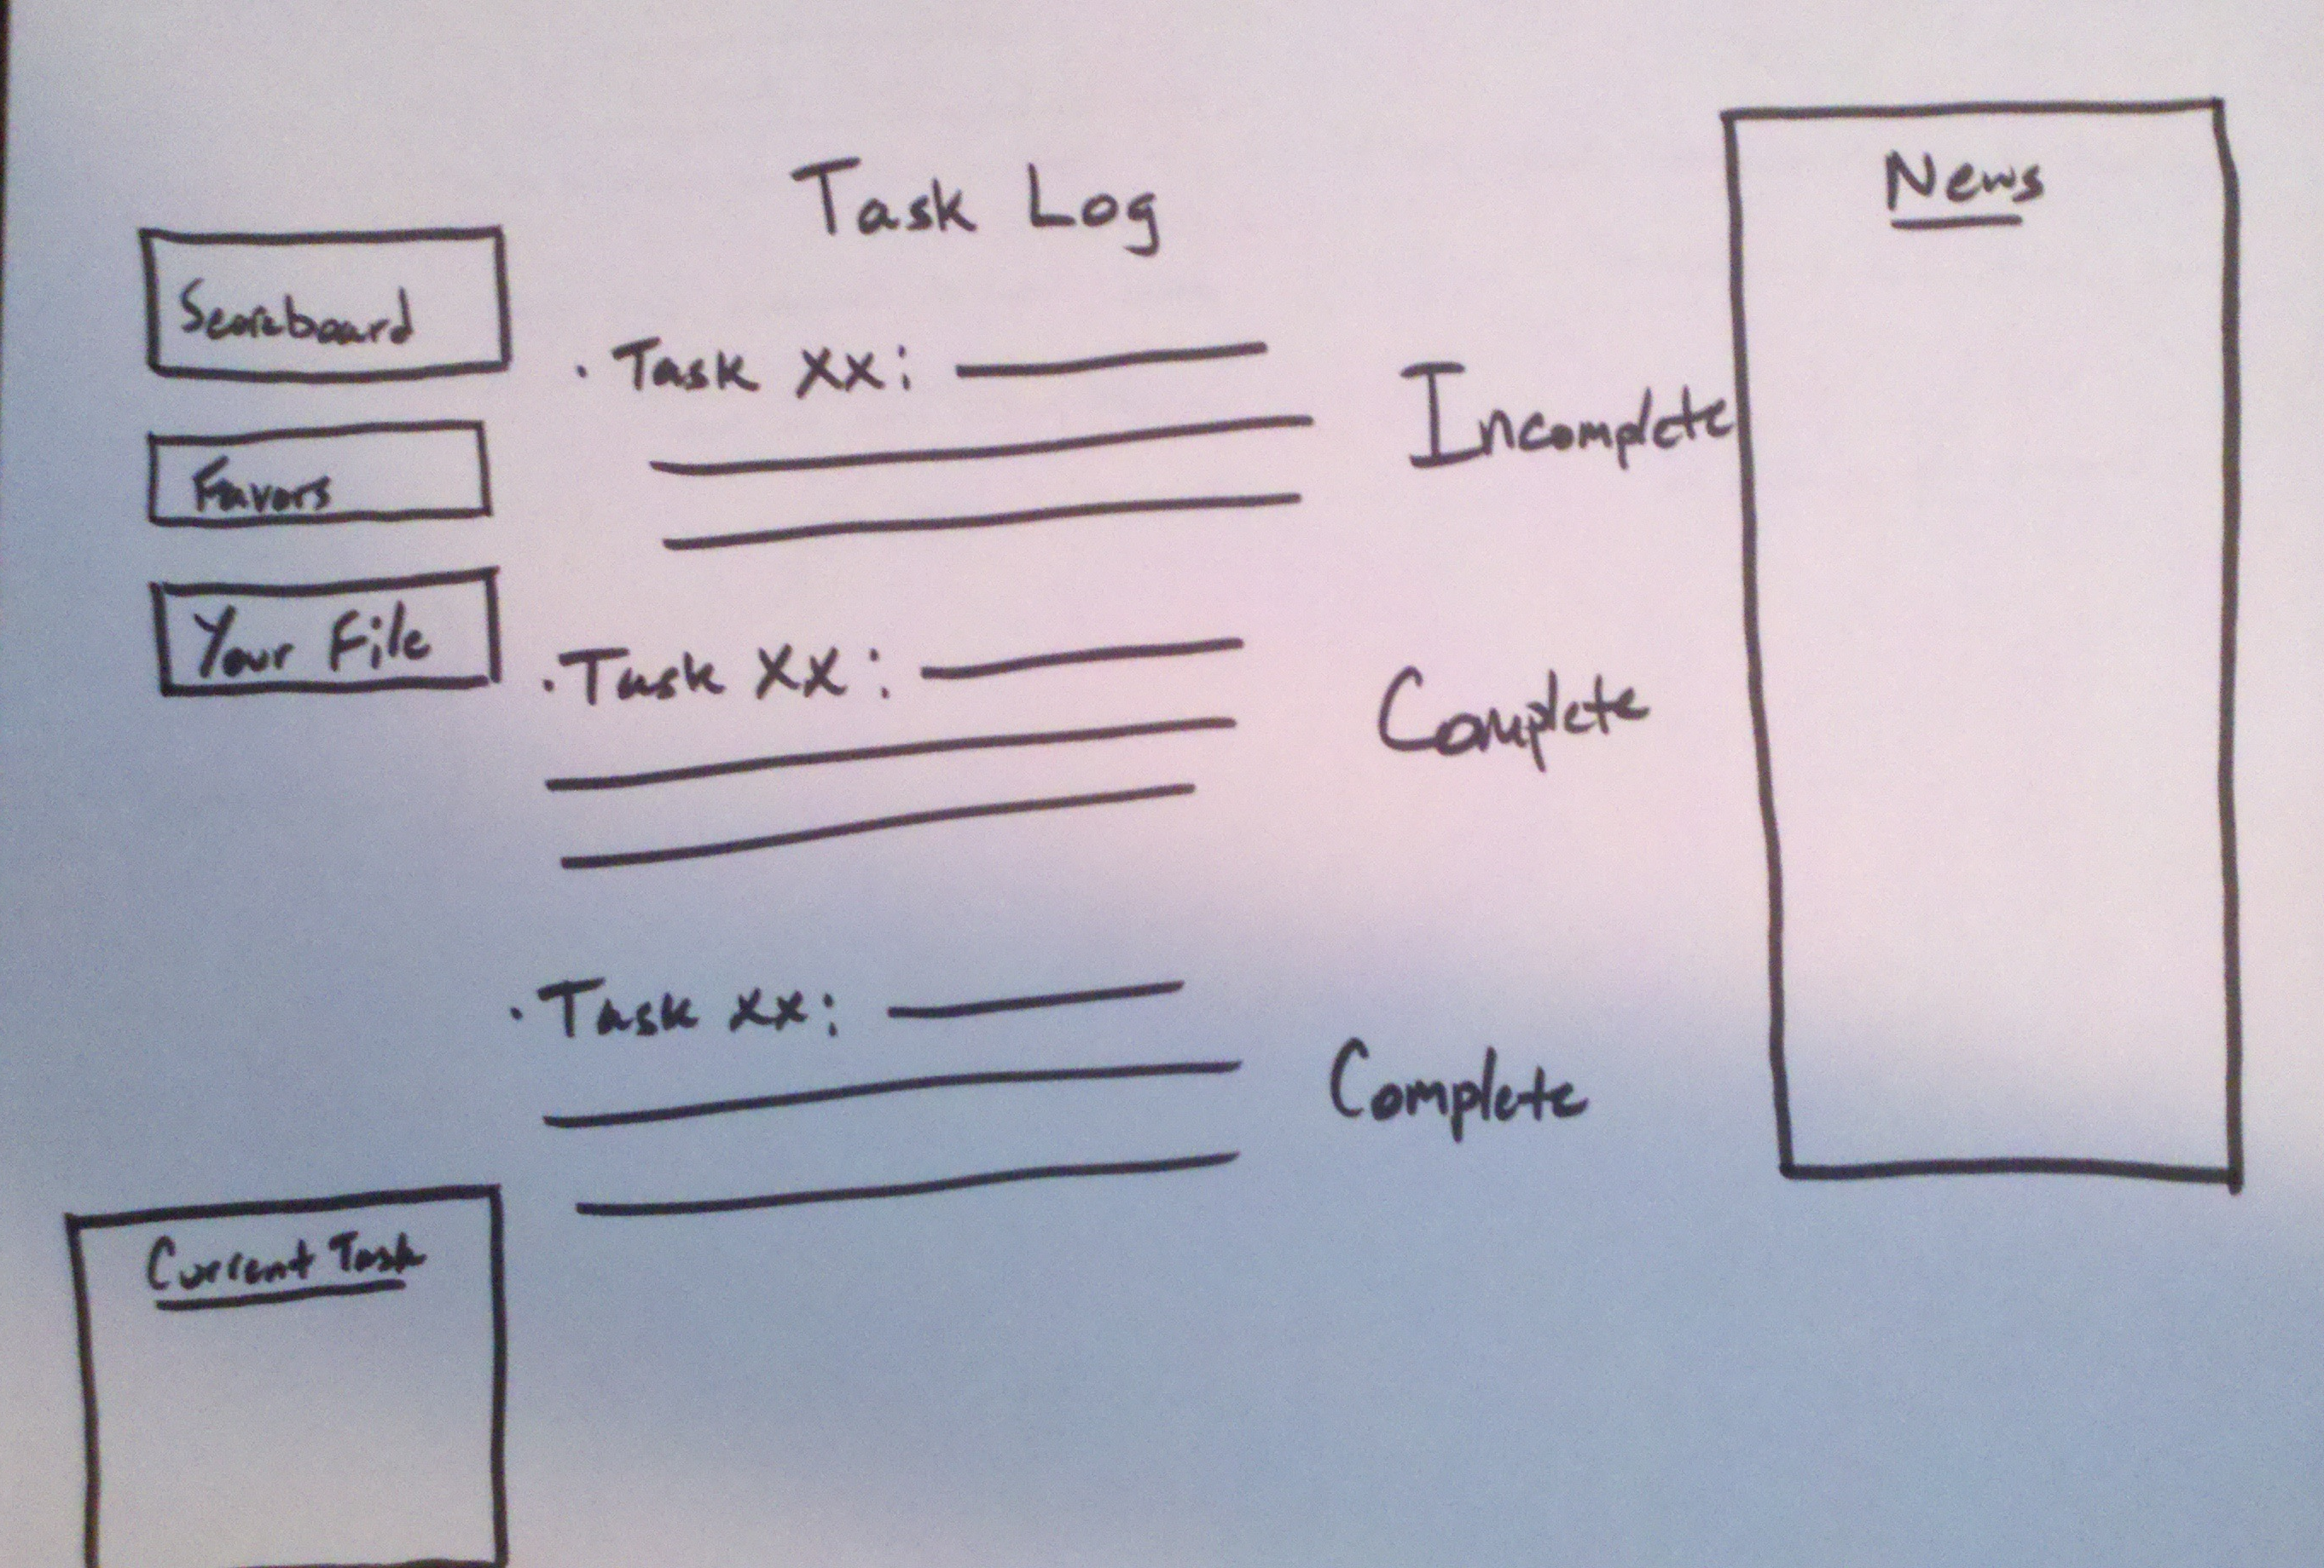
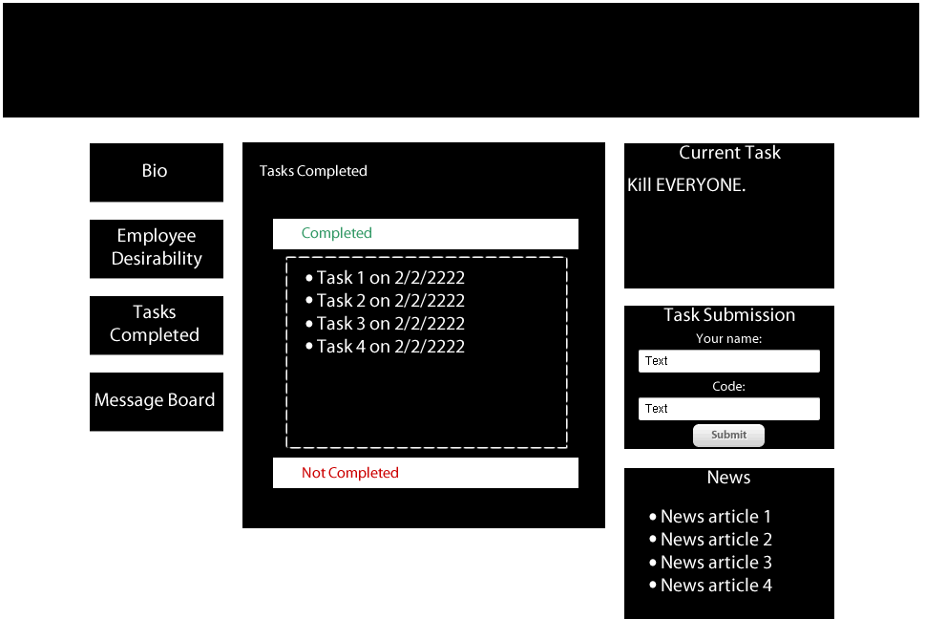
Notes:
This was created to allow players to see all tasks that have been completed by the player or may still be incomplete.

Slide 96
Notes:
The final version of the Task List page.

Slide 97
“It seemed too complicated and would take up too much time.”
Evaluation Feedback
Notes:
“Overall I like the idea of the game. Good job!”
“Thanks for the game, it was fun!”
When asked about the participants least favorite part of the game:
“It seemed too complicated and would take up too much time.”
“Slow response time to validate codes. I would have wanted an automated code validator after submission, so I could know if something counted right away.”
“Figuring minor things out was a bit of a hassle because i have my own to do list - didnt really want to sit and try to find things on the site”
When asked about participants favorite part of the game:
“I liked the task where we had to find an image in the basement of INFO-E. There's something about physically searching for an item that makes the game more exciting.”
“the variety of challenges."
“socialization”

Slide 98
“I liked the task where we had to find an image in the basement of INFO-E. There's something about physically searching for an item that makes the game more exciting.”
Evaluation Feedback
Notes:
This particular response was from being asked “what their favorite part of the game was”

Slide 99
Motivation
Future Considerations
Volunteering, Community service
Notes:
Alternate reality games might be able to provide additional motivation in other tasks by turning those tasks into the context of a game.
Motivation. ARGs could pose as a motivational tool for volunteering or community service.

